Slide 1

Using vignettes to address stereotypes and preconceptions about students
Celia Popovic, York University, Toronto
Tuesday, July 15, 2014
Notes:
2 hour workshop.

Slide 2
Plan – to hide – 12 noon to 2.00 pm
12.00 to 12.10 – Introductions briefly me, round of names and where from
12.10 to 12.20 Stereotypes – match dogs to owners
12.20 to 12.40 Preconceptions why we have them
12.40 to 12.50 research results
12.50 to 1.35 Students’ beliefs about effective learning
1.35 to 2.00 Questions, close and evaluation

Slide 3

York University – Toronto not Yorkshire!
Notes:
12.00 to 12.10 Introductions

Slide 4
Notes:
12.10 to 12.15 We all make assumptions about people. Can you match the dogs to the owners?

Slide 5
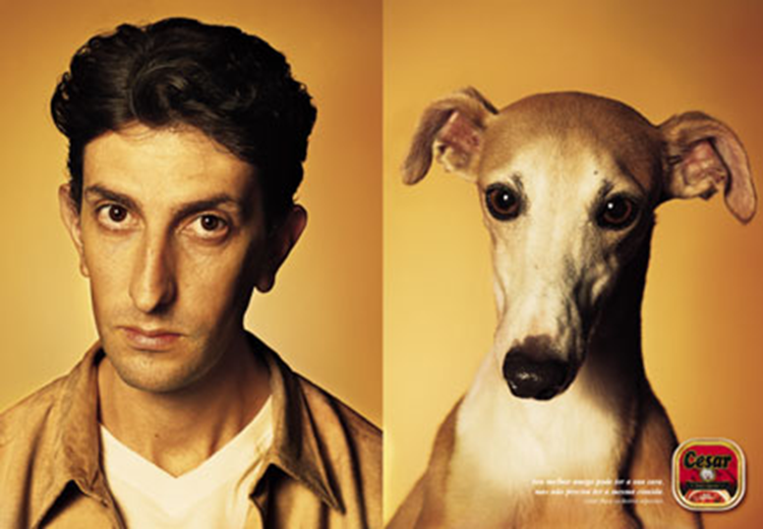
The Power of Stereotypes
Notes:
12.15 to 12.30 Why do we have preconceptions – look for patterns – dogs and owners looking alike – also cover the research info in this section

Slide 6

Saves time!

Slide 7

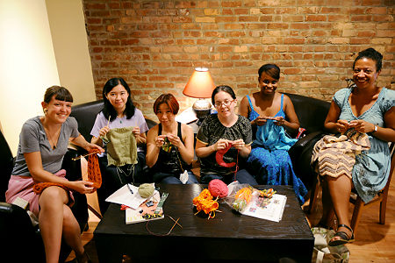
Homophily
Notes:
Seek out people like us

Slide 8
Confirmation bias
Notes:
Actually one is a man the other is a dog! And it is an advert… Ignore what doesn’t support our preconception and over value that which does support it.

Slide 9

Danger of stereotypes

Slide 10
Understanding preconceptions
Meaning: categorize based on available knowledge
Distinctiveness: set your own group apart
Enhancement: set your own group above
Reality: interpret real data

Slide 11

Before we go any further

Slide 12
Research project
What do university teachers believe about their students – can they predict who will do well, who will not?
Which students have the identified characteristics?
How do they perform?
Are the teachers right in their beliefs?
What can we do about this, if anything?
Notes:
12.30 to 12.40 International research project looked at teachers’ beliefs and compared them with student performance. Some proved to be correct and others incorrect.

Slide 13
Beliefs common to the US and the UK
Expect to develop different study habits from those that worked at high school
Are punctual for lectures and classes
Keep up with the assigned reading
Prefer to sit towards the front in class
Perform some paid, voluntary or service work
Choose to come to university of own volition
From particular ethnic group
Have a particular gender
Talk with teacher and ask questions
Actively form their own study groups
Notes:
12.40 to 1.10Handout list –ask them to predict which would expect to be true of their students
Then in groups (depending on numbers and time) get them in groups to tackle a couple of the issues = what might this mean if it is true, what if anything can be done.
1.10 to 1.20 present findings back to each other

Slide 14
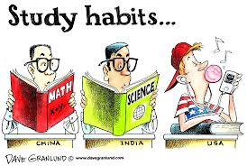
Expect to develop different study habits from those that worked at high school
Notes:
1.20 to 1.35 go through all the items, just add anything they didn’t mention
What worked at school may not work at Uni – but unless you tell people, how do they know? Need to be explicit – what do you expect them to do with their time? How should I spend 30 mins between classes, etc. Build in development of study habits into the course work.

Slide 15
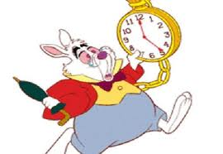
Are punctual for lectures and classes
Notes:
Yes – no big surprise –not necessarily that being punctual makes you a success, but successful students are punctual according to our findings. Can share this observation with students – stands to reason if you are there to hear what is said you have more chance of understanding what is going on. Can you also build in incentives to be punctual – start on time regardless if half the class is not there. If this happens repeatedly is it because of a timetable clash hat you could address? Provide answers to questions you promise are on the test in the first 5 mins and don’t tell the latecomers…

Slide 16

Keep up with the assigned reading
Notes:
Stands to reason – but what are the reasons for students not keeping up. Few people actively want to fail. Are you giving them too much? Are you explaining what you mean by reading? Are you judging what is reasonable by your own reading rate?

Slide 17

Prefer to sit towards the front in class
Notes:
Nothing magic about the front two rows – but our research did find a connection – not necessarily cause and effect! What can you do? Make them move around especially if it is a long lecture – change of position can wake up brain cells. You can move around – get in among them. Why might front rows do better? Do you address all your comments to them? Are you more likely to know the names of front row students? What can you do to help those at the back feel more engaged?

Slide 18

Perform some paid, voluntary or service work
Notes:
Although our instructors thought limited paid work would result in a good work ethic, research didn’t support it, and found that excessive work (as expected damaged students’ chances of a high grade). If work ethic does help – how else might you encourage this?

Slide 19

Choose to come to university of own volition
Notes:
Another one not supported by our research Various reasons – assumption in minds of instructors that students who just come because teachers or parents expect them to do so wont be as motivated as those who actively made the choice. However reverse can also be true, without support of family and wider community can be even more difficult to succeed and to keep going when things get tough.

Slide 20

From particular ethnic group
Notes:
Rather shocked to hear this, but was a claim made by a range of people and a range of ethnicities – not all minor ones. Our research didn’t find a link – although in an earlier study with med students I did find that what looked on the surface to be an ethnic difference turned out to be an issue of economic privilege- wealthier medical student did better than poor ones, and the poor ones tended to come from a particular ethnic group. Suggest if this does look like an issue with any of your student groups that you explore if it really is the case and if so what might be causing it.

Slide 21
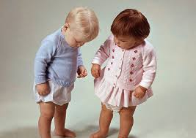
Have a particular gender
Notes:
In some cases instructors favoured men, and others women. In most cases it was where there was a distinct gender imbalance – the minority group always expected to perform worse than the majority. Not held up by our research, but could be all sorts of reasons, and could be true of a group of your students. Point is to find out if it is happening and if so try to work out and address the reasons.

Slide 22

Talk with teacher and ask questions
Notes:
Another surprise- teachers though those who asked questions were more engaged and therefore more likely to succeed. Our research didn’t uphold it but remember we asked studetns at the start of the year what they expected to do not what they actually did. So might have got a different answer if asked this later. Also – students might have thought were talking about trivial questions about hand in dates for example, while teachers meant engaging that bit further with the material, pushing their knowledge etc.
If it is the case that inquisitive students do better (as most of us would expect) what can we do to encourage that behaviour?

Slide 23

Actively form their own study groups
Notes:
Limits of our research – in face of other evidence! Example of the way we asked the question – do you intend to form a study group, not if they did or not. So another one like the last one – and one where need to find ways to encourage and support students in forming their own groups.

Slide 24
Upheld/not upheld
Expect to develop different study habits from those that worked at high school
Are punctual for lectures and classes
Keep up with the assigned reading
Prefer to sit towards the front in class
Perform some paid, voluntary or service work
Choose to come to university of own volition
From particular ethnic group
Have a particular gender
Talk with teacher and ask questions
Actively form their own study groups
Notes:
Summary – remember was our findings – it was the preconceptions themselves that mattered most – and will be different for you and your students.

Slide 25
Students’ beliefs
Motivation
Diligence
Attendance
Homework and Preparation
Learning Strategies
Notes:
1.35 to 1.55 In the book we give some concrete suggestions for addressing the issues raised here, only have limited time in this workshop, and of course you will have your own approaches that work in your context. But for now will give some suggestions for addressing the mismatch between students’ beliefs and their actions.
We asked the students what they thought were the characteristics of a good learner. These were the top 5 aspects – there were others and these may not be the same as your students, but likely to be similar. Will address each one offer some ideas for addressing them. Interesting to note that students often said they thought it was important to be motivated or diligent then did the opposite…

Slide 26

Motivation
Notes:
17% of students saw this as the number one issue – if you really want to learn you will. A belief shared by teachers – but how do we encourage this? Extrinsic motivation may help – need the grade or make the activity a required element – but intrinsic is much more powerful.
Ideas we suggest -
3 components – supportive learning environment, expectation to succeed and value. You work on the first two – but the third on value can help students by asking them write down what they think will motivate them personally. Two columns – content related on left, process related on the right – eg on left I am fascinated by bridges, ancient Greece, on the right I enjoy presentations, service learning etc. In other words help the students to identify why they are taking the course and what they hope to get out of this particular module. Encourage students to set themselves two specific challenges, one process related eg I will get better at managing group work, and one content related. If you share as a group you can point out assignments or activities most likely to help them achieve their challenges.

Slide 27

Diligence
Notes:
17% also cited hard work or diligence as a vital factor – they typically know hard work is required, but they also often admit to not giving as much as they could or should.
Ideas we suggest- engage students in an activity about the amount of studying they should expect to do. May be that they are balancing their studies with other things – paid work, voluntary work, student activities, families, sport – not just because they are intrinsically lazy! Make it clear how much time you expect them to spend on a given task (while allowing for variations between students) – but also encourage them to make a careful note of how they really are spending their time – for one week keep a detailed diary. If not enough time spent on studies can they see where they are spending time that could be diverted to their studies.

Slide 28

Attendance and Punctuality
Notes:
In the US students tended to mention attendance (this is often given a credit) and in the UK they talked about punctuality – importance of turning up on time.
Our research showed correlation between students who said they turned up regularly and were usually on time and those who got the best grades. Just telling students this small but important fact might help shift the behaviour – for first years in particular they may find this is the first time in their lives that they have complete freedom over how to spend their time, and they may not be making the most sensible choices.
If you use ground rules or contracts include punctuality as an item. Discuss with the class the impact on the individual and the rest of the group if people don’t’ turn up or turn up late. Don’t reward latecomers by rehashing everything they missed, and don’t teach them that the class really starts 5 or 10 minutes after the timetable says it does – start on time and keep going. If the majority are consistently late you might want to look into the reasons – are they coming from another lecture across campus for example.

Slide 29

Homework and Preparation
Notes:
In our research more than half the students cited this as important for success, however a smaller number said they actually did all they were asked or more than was required.
Our suggestions – make it clear what is required. If you have a ground rules discussion use this to make it explicit that not only do they short change themselves if they don’t do the prep work , but also each other.
If you set homework make sure you refer to it in the subsequent class – help the students to see why you asked them to do the reading or the activity, otherwise next time they may not see the point.

Slide 30

Learning Strategies
Notes:
Students told us that they realized they needed to change their learning behaviour, especially those who came to university from high school.
Our suggestions-
Embed short segments on learning strategies in your class contact time – eg notetaking while reading – explain to students the norm for reading in your discipline – for example should they read through from start to finish or does is it more efficient to read the abstract, headings and subheadings, tables and figures, first and last sentences of paragraphs and only read whole para if doesn’t make sense – alternatively in another discipline might make more sense to read the abstract, discussion and conclusions, findings, method and intro only if needed. You learnt to read like this, students don’t automatically know too.
Invite the learning centre into your class to discuss a particular learning strategy at a point when it is going to be of most use to the students. Include former students who have developed exceptional learning strategies.

Slide 31

Any questions?
Notes:
1.55 to 2.00 and hand out evaluation form

