Slide 1


Principles for Whole of Course Curriculum Design to Develop and Assure Student Learning Outcomes
Romy Lawson
University of Wollongong

Slide 2
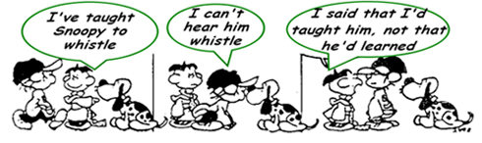
What are we trying to achieve when we teach?

Slide 3

The Quality Code – ASA/QAA
The Quality Code has sets out the expectations that all providers are required to meet, grouped into three parts:
Part A on academic standards
Part B on academic quality
Part C on information about higher education provision
Part A also includes the qualifications frameworks (FHEQ: Levels 4-8) and the subject benchmark statements
“Higher education providers make available definitive information on the aims, intended learning outcomes and expected learner achievements for a programme of study.” A3
A programme specification is a concise description of the intended learning outcomes of a Higher Education (HE) programme, and the means by which the outcomes are achieved and demonstrated.
http://www.qaa.ac.uk/assuring-standards-and-quality

Slide 4
So why are you here?

Slide 5
What I’ve learnt from my fellowship!
Romy Lawson
University of Wollongong

Slide 6

Hunters & Gatherers: Strategies for Curriculum Mapping and Data Collection for Assurance of Learning
assuringlearning.com

Slide 7

How do we assure learning?
Write Degree LOS
Map Degree LOS
Collect Evidence
Use Evidence
Benchmark

Slide 8
How do we assure learning?
Write Degree LOS
Map Degree LOS
Collect Evidence
Use Evidence
Benchmark
HOLISTIC
COLLABORATION
SUSTAINABLE
INTEGRATED

Slide 9

The magic words . . .
Holistic - a whole of Courseapproach was important to ensure students' progress in a way that ensures Degree LOs can be introduced and then further developed before they are assured on completion of their award.
Integrated - in order for Degree LOs to be valued by academic teaching staff and students they had to be embedded into the curriculum, and linked to assessment.
Collaborative - the process had to be developed in conjunction with the academic teaching staff in an inclusive rather than top down approach, so that staff engaged with, and recognised the importance of the process.
Maintainable - any process that is implemented has to be sustainable to ensure it is not reliant on individuals or resources - streamlined.

Slide 10
How do we assure learning?
Design Curriculum
Write Degree LOS
Map Degree LOS
Collect Evidence
Use Evidence
Benchmark
Engage Students
Facilitate Learning
Review Practice
Assess Learning

Slide 11
Principles for Design
Holistic:
  whole of Course approach;
  setting expectations;
  creating rubrics;
  calibrating understanding;
  engaging students (whole of Course)
Integrated:
  authentic, scaffolded assessment;
  assessments provides context and level;
  teaching activities;
    embedded;
    modeling & exemplars;
  feedforward
Collaborative:
  vision
  executive support
  guiding team
  training
  reward and recognise
  empowerment
  communicate for buy-in

Slide 12
Principles for Design
Holistic:
  whole of Course approach;
  setting expectations;
  creating rubrics;
  calibrating understanding;
  engaging students (whole of Course)
Integrated:
  authentic, scaffolded assessment;
  assessments provides context and level;
  teaching activities;
    embedded;
    modeling & exemplars;
  feedforward
Collaborative:
  vision
  executive support
  guiding team
  training
  reward and recognise
  empowerment
  communicate for buy-in

Slide 13
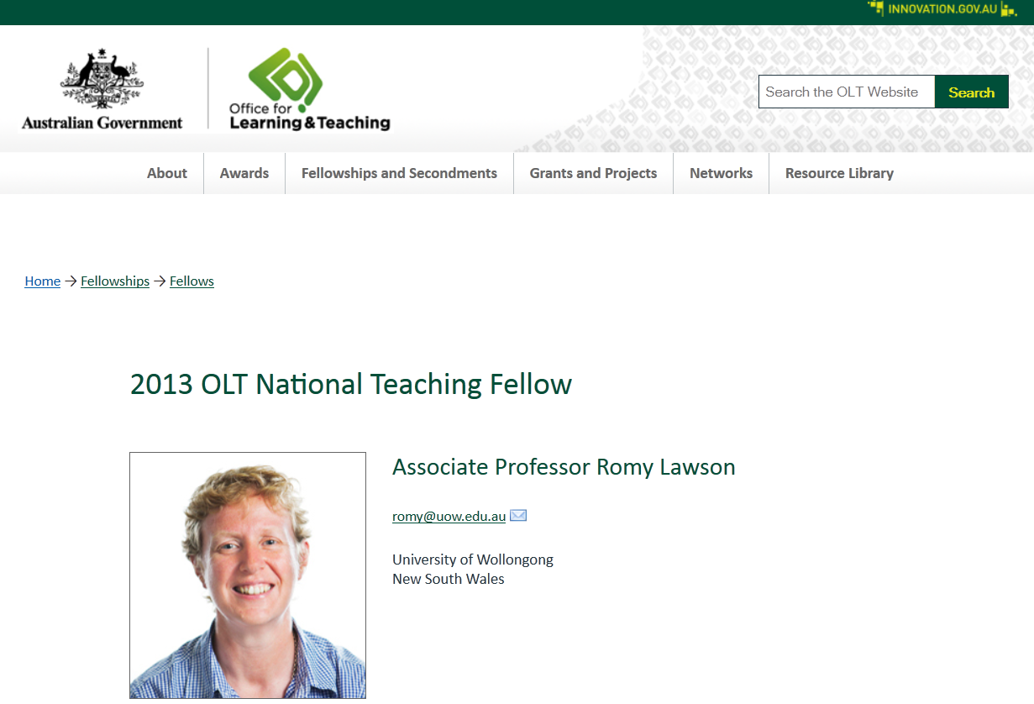
Curriculum design for assuring learning in business education - leading the way

Slide 14
Designing learning
Learning Outcomes
What should the students be able to do/ know?
Learning Activities
What do the students need to do to learn?
Assessment
How will you/ students know if they can do it?
Evaluation
Has it been effective?
What can be improved?

Slide 15
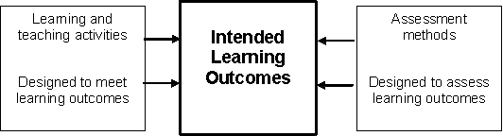
Constructive Alignment
John Biggs, 2000

Slide 16

Whole of Course Approach

Slide 17
Whole of Course Approach
Critical Thinking
Ethical Awareness

Slide 18
Whole of Course Process – How?
Writing Course Learning Outcomes
Understanding Criteria and Standards needed to achieve the Degree LOs (whole of Course rubrics)
Designing Authentic Scaffolded Assessment of Degree LOS
Teaching Degree LOs with Effective Feedback/Feedforward Mechanisms
Leading the Process – Facilitating Change

Slide 19
How do you design/deliver your curriculum?
Whole of CourseChecklist
Stages | Current |  | Areas for Development
 | Subject | Course
setting expectations (Degree LOs)
creating rubrics
calibrating understanding
assessment authentic scaffolded valid
feedback/feedforward
student evidence

Slide 20
Designing learning
Learning Outcomes
What should the students be able to do/ know?
Learning Activities
Assessment
Evaluation

Slide 21
Benefits of Learning Outcomes
Learning Outcomes maximise student study efforts and encourage independent learning by making the teacher’s focus and decision-making for assessment transparent.
They provide lecturers with a guide for what should be assessed
They provide the basis for lecturers and tutors to link teaching design and teaching activities with desired student results
Learning outcomes provides Course teams/students with the opportunity to demonstrate which graduate skills are developed in their Course
They provide the basis for evaluating Course effectiveness in relation to student learning.

Slide 22
Step 1
Have you got the right Degree LOs?

Slide 23
Degree LO - Considerations
National (International)
  FHEQ; Subject Benchmarks; Professional Bodies eg CPA

Slide 24
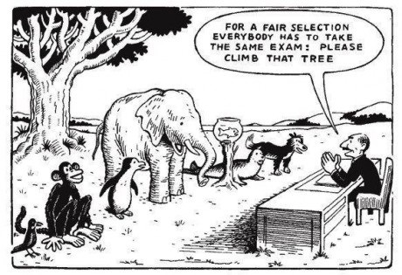

Slide 25
Degree LO - Considerations
National (International)
  FHEQ; Subject Benchmarks; Professional Bodies eg CPA
Institutional/Faculty
  University requirements (point of distinction) – GA/ Themes
Degree
  Context
  Level

Slide 26
What does a graduate look like?
The Six Thinking Hats (de Bastardised Bono)
The White Hat
What do you think a graduate should look like.
The Red Hat
What do students want to achieve.
The Black Hat
What does industry/the profession want from graduates.
The Yellow Hat
What do regulatory bodies want your Course to achieve.
The Green Hat
Who are you marketing the Course at.
The Blue Hat
What does your institution want a graduate to look like?
Does your Course achieve all this?

Slide 27
Learning Outcomes Checklist
Read each learning objective - Yes/No
Does it speak directly to the learner? (refer to what student might achieve, not what teacher will do)
Is it measurable?
Does is target one specific aspect of expected performance?
Does it use an effective action verb?
Does it match instructional activities and assessments?
Is it written in terms of observable behavioural outcomes?

Slide 28
Whole of Course Design Tool
Login

Slide 29
Streamlined Approach
External – Govt (QAA), Prof Bodies
Internal - University GA/Themes
Degree Level - Degree LO

Slide 30
Streamlined Approach
Degree LO
Subject LO
Assessment

Slide 31
Streamlined Approach
Degree LO
SILO
Assessment

Slide 32
Streamlined Approach
Degree LO
Subject LO
Assessment
(Context/Level)

Slide 33
Designing learning
Learning Outcomes
Learning Activities
Assessment
How will you/ students know if they can do it?
Evaluation

Slide 34
Rubrics
In order to ensure standardisation of assessing Degree LOs across Courses a series of assessment rubrics have been developed to measure the Degree LOs.
A rubric identifies the criteria that are to be used to evaluate competence in each Degree LO (along the left hand side) with a description of the expected level to achieve each standard (across the top). The standards are divided into three categories – below, meets and exceed expectations – these are also aligned to the more familiar grading process of F to HD.

Slide 35
Step 2
Creating Degree LO Rubrics

Slide 36
Assessment Task
STANDARD | BELOW EXPECTATIONS | MEETS EXPECTATIONS | EXCEEDS EXPECTATIONS
GRADE CRITERIA | Z → | P → C | D → HD
Demonstration of inter-relationships between differing business related disciplines | Limited demonstration of integration between disciplines. e.g. identification or description only. | Sound demonstration of integration between disciplines. e.g. examination, explanation, interpretation, application or analysis of interrelationships. | Comprehensive demonstration of integration between disciplines. e.g. detailed examination, insightful analysis or interpretation, synthesis, extrapolation, evaluation and/or recommendations.
Application of critical understandings of theoretical concepts underpinning perspectives in industry based scenarios. | No / little application of critical understandings demonstrated. e.g. Only one perspective drawn on to demonstrate concepts. | Application of critical understandings demonstrated. e.g. 2-3 perspectives drawn on to demonstrate concepts. | Convincing application of critical understandings demonstrated. e.g. Relevant and innovative application drawn from multiple / global perspectives.

Slide 37
Whole of Course Rubric
Degree LO1 Demonstrate essential knowledge necessary for a career in business related professions
 | Year 1: Foundation | Year 2: Intermediate | Year 3: Competent
A Appreciation of essential concepts necessary for a career in business and related professions. | Describes essential concepts of business. | Explains essential concepts of business, demonstrating application of concepts. | Interprets essential concepts of business hypothesising, and assessing aspects of the concepts.
B Critical analysis and evaluation of essential concepts. | Demonstrates some critical analysis/evaluation of essential concepts. e.g. Reference to concepts through definition or description only. | Demonstrates sound critical analysis / evaluation of essential concepts. e.g. analysis demonstrated through explanation, discussion, investigation, application, interpretation of concepts. | Demonstrates thoughtful critical analysis and evaluation of essential concepts. e.g. involvement of reflection, judgment, problem-solving, synthesis, assessment, prediction.
C Consideration of the economic, social and cultural environments within which international businesses operate. | Demonstrates some consideration of the economic, social and cultural aspects of international business context. | Demonstrates sound consideration of international economic, social and cultural differences between cultures and how these differences impact ways that business operates. | Demonstrates high level understanding of international economic, social and cultural environmental issues in an international business situation. e.g. accurate explanation of relevant actions and prediction of responses.

Slide 38
K1 Demonstrate essential knowledge necessary for a career in business related professions
 | Year 1: Foundation | Year 2: Intermediate | Year 3: Competent
A Appreciation of essential concepts necessary for a career in business and related professions. | Describes essential concepts of business. | Explains essential concepts of business, demonstrating application of concepts. | Interprets essential concepts of business hypothesising, and assessing aspects of the concepts.
B Critical analysis and evaluation of essential concepts. | Demonstrates some critical analysis/evaluation of essential concepts. e.g. Reference to concepts through definition or description only. | Demonstrates sound critical analysis / evaluation of essential concepts. e.g. analysis demonstrated through explanation, discussion, investigation, application, interpretation of concepts. | Demonstrates thoughtful critical analysis and evaluation of essential concepts. e.g. involvement of reflection, judgment, problem-solving, synthesis, assessment, prediction.
C Consideration of the economic, social and cultural environments within which international businesses operate. | Demonstrates some consideration of the economic, social and cultural aspects of international business context. | Demonstrates sound consideration of international economic, social and cultural differences between cultures and how these differences impact ways that business operates. | Demonstrates high level understanding of international economic, social and cultural environmental issues in an international business situation. e.g. accurate explanation of relevant actions and prediction of responses.

Slide 39
 | Below F | Meets P C | Exceeds D HD
Subject LO
Subject LO
Subject LO
Degree LO1 | Describes essential concepts of business | Explains essential concepts of business, demonstrating application of concepts. | Interprets essential concepts of business hypothesising, and assessing aspects of the concepts.
Degree LO1 | Demonstrates some consideration of the economic, social and cultural aspects of international business context. | Demonstrates sound consideration of international economic, social and cultural differences between cultures and how these differences impact ways that business operates | Demonstrates high level understanding of international economic, social and cultural environmental issues in an international business situation. e.g. accurate explanation of relevant actions and prediction of responses.

Slide 40
Degree LO 1
8 – Synthesize complex conflict and related theories and standards for professional practice in CMR.
9 - Evaluate complex conflict and related theories and standards for professional practice in CMR.
Criteria | Grad Cert Fail | Grad Cert Pass MCMR Fail | Grad Cert Exceeds MCMR Pass | MCMR Exceeds
1(a) Understands the theories and standards for the purpose of applying them in practice | Does not identify key concepts of theories/standards and/or does not explain their relevance to practice. | Explain the key concepts of complex theories/standards in the field and their relevance to practice. | Comprehensively explains complex theories/standards in the field and their relevance to practice. | Comprehensively explains and critically analyses complex theories/standards in the field and their relevance to practice.
1(b) Demonstrate interrelationships between complex conflict and related theories and standards | Does not draw any links between theories and/or standards. | Explain the relationships between key concepts of complex conflict and related theories and standards | Comprehensively explains the relationships between complex conflict and related theories and standards. | Comprehensively explains and critically analyses the relationships between complex conflict and related theories and standards.
1 (c) Draw conclusions | Conclusions not logically linked to theories and standards. | Draws logical conclusions from theories and/or standards. | Draws and explains logical conclusions from theories and/or standards. | Draws and critically justifies conclusions from theories and/or standards.
1 (d) Apply theory/standards to practice. | Incomplete application of theories/standards to practice. | Applies theory/ standards to practice, utilising the main elements of the theory/standards | Effectively applies theory / standards to practice utilising relevant elements of the theory/standards. | Produces a comprehensive application of theory/standards to practice utilising relevant elements of the theory or shows innovation in application.

Slide 41
Rubric Links
http://boliver.ning.com/page/standards-rubrics-business-and-law
http://www.aacu.org/value/rubrics/index.cfm

Slide 42

Judging a Degree LO
Select a Degree LO
Brainstorm
  How would students demonstrate the competence in industry/profession/real life?
  How would you judge if it was good?
Develop a Degree LO rubric

Slide 43
Degree LO
Criteria | Grad Cert Fail | Grad Cert Pass MCMR Fail | Grad Cert Exceeds MCMR Pass | MCMR Exceeds

Slide 44
Whole of Course Design Tool
Login

Slide 45
Step 3
Designing Authentic Assessment

Slide 46
Designing a Degree LO Assessment
Select a Degree LO
Brainstorm
  How would students demonstrate the competence in industry/profession/real life?
Translate this brainstorm into authentic assessment tasks

Slide 47
Authentic Scaffolded Assessment
‘Real’ tasks can motivate and stimulate students more than the same material in abstract form. Authentic tasks reflect what occurs in settings beyond the educational environment.
They need to be experienced as authentic by students, rather than having all of the aspects of a full professional problem. Tasks may need to be simplified if they would lead to students being swamped or overloaded with material and issues they are not ready to handle yet.
Undertaking authentic tasks
Authentic tasks often require students to identify a problem from the context and to address it in ways that a practitioner would.
When authentic environments are created within a Course, 'real' assessment tasks can readily be produced. However, such tasks may be created without an entire simulated environment.
While authentic tasks may obviously be undertaken in an external practice setting, the emphasis here is on utilising them as a normal part of Course activity within the university.

Slide 48
Authentic Scaffolded Assessment
Assessment activities often fragment knowledge rather than consolidating it in ways that might be used in practice.
By contrast, integrative activities are intended to link different kinds of work within a module, across modules and stages (e.g. years and semesters, or between the Courseand practice settings.
Integrative activities
Students assemble and re-process their work from different sources or parts of the Course, often reflecting and analysing their own work.
Students repackage earlier assignments to prompt reflection on themes beyond those for which the tasks were originally completed.
Integrating assessment over a single unit or module
Integration involves a sequence of linked assessments over several tasks.
It can include developing an assignment in stages (see above, Integrative activities) or having a set of compatible assessment tasks that together build capacity for further learning and develop skills in making judgements.
These activities develop students' knowledge and skills base and allow them to demonstrate a range of learning outcomes in coherent ways relevant to the module.
Integrating assessment across units or over time
Students receive cases to study two weeks before an examination. The exam tests integration of knowledge across different areas, in various forms eg. short answer or multiple choice. It requires knowledge of application which cannot be found in the cases or set texts alone. Students often cooperate by organising study groups to exDegree LOre the cases before the exam.

Slide 49
Step 4
Scaffolding Assessment

Slide 50
Scaffolding Assessment
Now look at this collection assessment tasks and ask
  How can you build throughout the Course(increase complexity) eg from level 8 (grad cert) to level 9 (MBA)? This is scaffolded assessment
  Example critical analysis may start with a simpler issue with just a couple of perspectives and build to a more complex dilemma with a multitude of perspectives and no real solution (a wicked problem)

Slide 51
Scaffold Assessment throughout Curriculum
Degree LO | Assessment 1 | Assessment 2 | Assessment 3 | Assessment 4
1 Written | Memo to manager | Letter to client | Executive Summary | Full report
2 Ethics | Case study (one issue) | Case study (multiple issues) | Current News Analysis | Real Wicked Problem

Slide 52
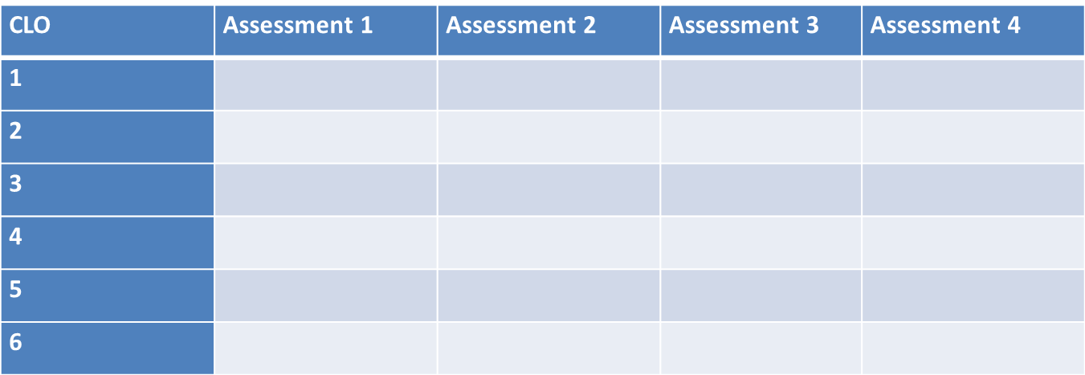
Record up to 4 assessments for each Degree LO in order of difficulty (1 = easiest/level 8)

Slide 53
Whole of Course Design Tool
Login

Slide 54
Step 5
Mapping into the Curriculum

Slide 55
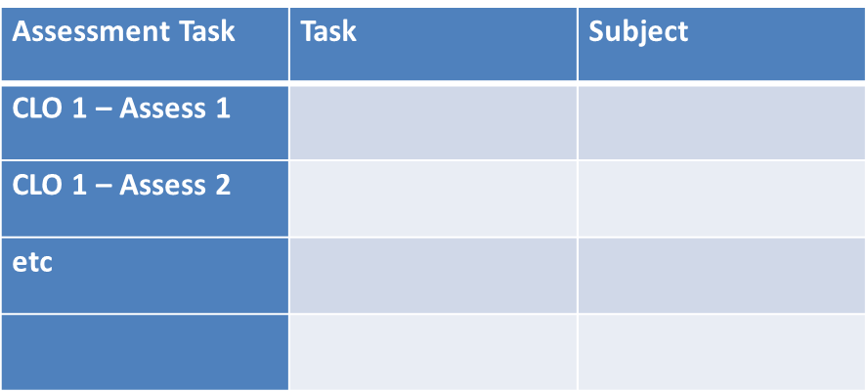
Map to embed into the curriculum
Memo to manager
HR 101
Letter to client
Mgt 201

Slide 56
Map in which subjects these assessments could be embedded

Slide 57
Whole of Course Design Tool
Login

Slide 58
Step 6
Engaging Students

Slide 59
Whole of Course Marking

Slide 60
Step 7
Calibration

Slide 61
Assessment –
How do we make judgements?
Sadler (2012) discusses commonly used options in assuring achievement including:
  overall results,
  external examiner systems,
  threshold standards and
  standardised testing,
but stresses problems with each of these methods unless a
  moderation and calibration process is included.

Slide 62
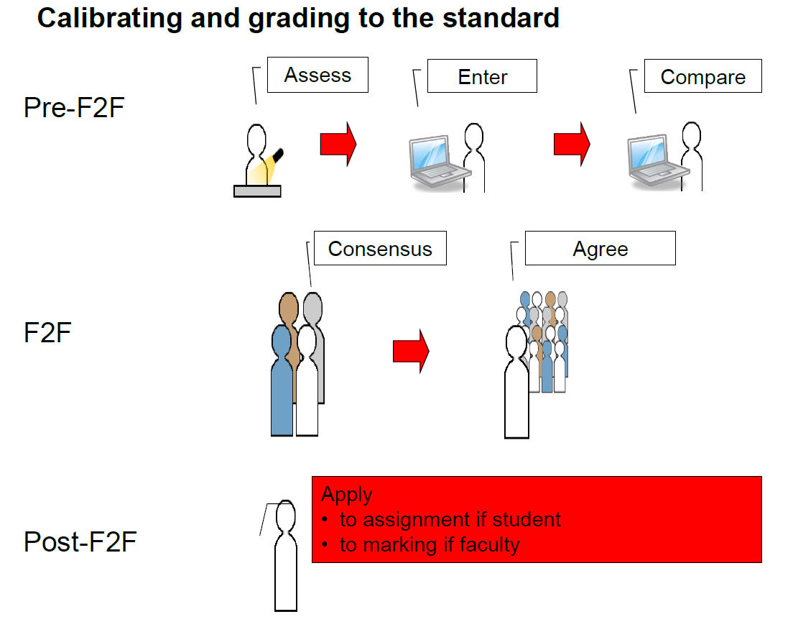
Calibration
Freeman, Hancock et al

Slide 63
Assessment –
How do we make judgements?
Yorke (2008) has also raised concern about adopting overall percentages as the indicator of quality.
What does a percentage or grade point average or degree classification actually tell us;
  which capabilities were actually assessed
  at what level;
  how grading was decided.

Slide 64
Assessment –
How do we make judgements?
BOTTOM UP
  With final percentage marks, students tend to gather evidence of achievement in a 'bottom up' way, collecting marks and grades during a Course, until they have sufficient to graduate.
  Problematic because in reaching the conciseness of an overall grade a loss of detail is inevitable, which prompts the need for supplementary material.
TOP DOWN
  Asking students to question ‘How have you satisfied, through your work, the learning outcomes stated?’
  Allows for a mixture of evidence including, qualitative assessments of performance in naturalistic settings (such as work placements), and claims of achievements that may not be formally assessable by the higher education institution but can nevertheless be supported by evidence.

Slide 65
Step 8
Evidence

Slide 66
Whole of Course ePortfolios
Yorke (2008) proposed that evidence can (some might say 'should') be created by students.
Creating ePortfolios is said to enable students to enhance their learning by giving them a better understanding of their skills and attributes, as well as where and how they need to improve to meet academic and career goals (Yancey, 1999).

Slide 67

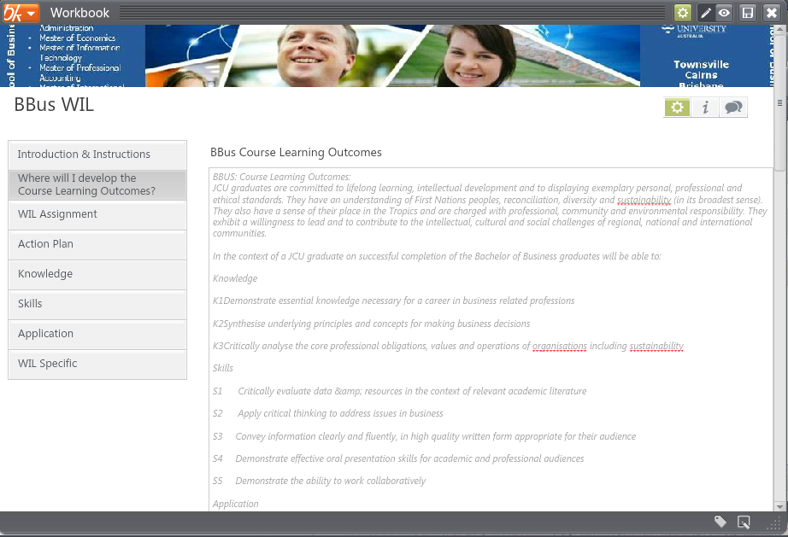
PebblePad

Slide 68
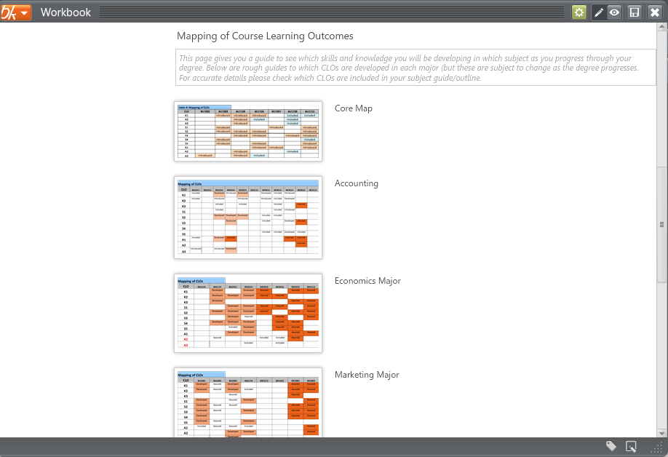
PebblePad

Slide 69
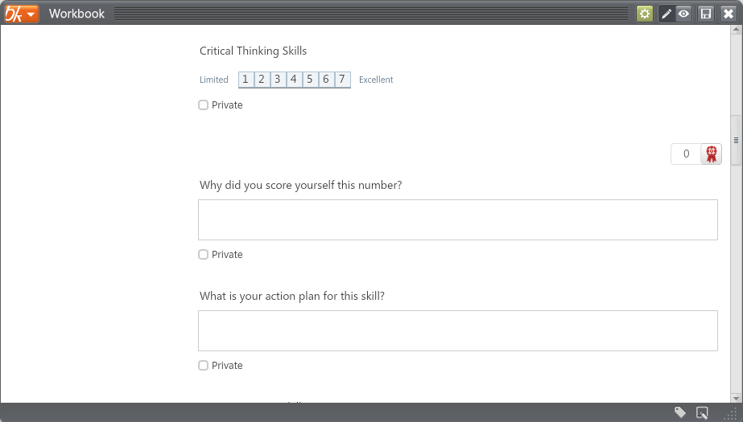

Slide 70
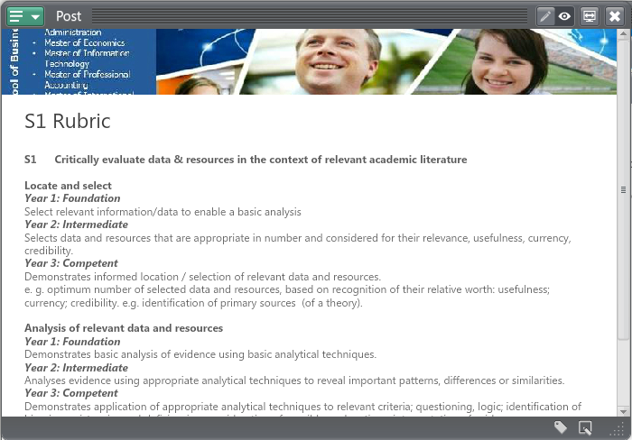

Slide 71
Conditions (11) under which Assessment Supports Student Learning
Gibbs & Simpson, 2004
Assessment tasks capture sufficient student time and effort
The assessment tasks distribute student effort evenly across time and topics
The tasks engage students in productive learning activity
Assessment communicates clear and high expectations to students
Feedback is sufficient, frequent and adequately detailed

Slide 72
Conditions (11) under which Assessment Supports Student Learning
Gibbs & Simpson, 2004
Feedback is provided quickly enough to be useful
Feedback focuses on learning rather than marks
Feedback is linked to the purpose of the assignment and to criteria
Feedback is understandable by students
Feedback is received by students and attended to
Feedback is acted upon by students to improve their work or learning
  http://www.open.ac.uk/fast/pdfs/aeq.pdf

Slide 73
Checklist for units/subjects/modules
This checklist is for those involved with units/subjects/modules (considered at the level of the assessment task)
How does the task develop students' capacity to assess
• their own work?
• the work of others?
Does the task encourage students to work productively with others (as distinct from collude with them)?
How does the task develop students’ ability to think critically and make judgements about their work?
What are likely students responses to the task? How can the task be framed to avoid inappropriate responses?
Has feedback about earlier versions of the task been used to revise it?
Is the task realistic or 'authentic' and linked to Courselearning outcomes as well as longer term learning aims?
Does the task encourage students to position themselves as active learners?
Is the task a learning activity in its own right and not just a compliance requirement?
What particular capacities does the task help build in students?
Have students had sufficient practice in some of the key areas being assessed (eg. through activities that are not formally assessed) for it to be a realistic task for them?
Will the task focus students’ attention on productive learning activities and lead them away from 'cramming' and plagiarism?
Is feedback used to help students calibrate their own judgements about their work
Is feedback from both peers and staff used, and are tasks scheduled so that students are able to utilize comments from others to improve their work?
How will the assessment task have a longer-term effect on students beyond the immediate period of assessment?

Slide 74
Checklist for Courses
The following checklist is an example of the sorts of questions that might be considered by those involved in Courses and Courses:
Does the overall balance of assessment activities across tasks fairly reflect the balance of learning outcomes for the Course/Course?
Are assessment activities in alignment with learning outcomes and teaching and learning activities and do they together promote a virtuous cycle of achievement? Is such alignment visible to students?
Do learning outcomes incorporate features such as building capacity for learning beyond the Course, development of students’ capacity to make judgements about their own work and that of others?
Do the assessment tasks within a Course/unit adequately reflect the main learning outcomes?
Do they contribute to the overall graduate attributes of the Course?
Are all assessment tasks judged according to standards made specific to the task rather than generic standards?
Are marks given and recorded in no finer detail than is appropriate for the accuracy of grading of the task (eg. it is not possible to reliably mark essays and reports to percentage accuracy)?
Are assessments across units coordinated to (a) avoid repetition of type of task, (b) avoid overloading students at particular times, and (c) ensure appropriate coverage of learning outcomes?
Are all staff aware of the assessment tasks required of students in other units/Courses across the Courseand within the semester?
Is assessment normally discussed in all Course, Courseand assessment meetings primarily in terms of impact on learning, and secondarily in terms of fairness, consistency, etc.?
Is timing of feedback relative to opportunities for students to utilise feedback considered regularly?
Do Courseand Courseteams regularly consider information about students’ responses to assessment as part of quality assurance deliberations?
Is the overall assessment in a Courseor Coursesuch that it can be plausibly concluded that it will build the capacities of students to continue their own learning and assessment after graduation?

Slide 75
Assessment . . .
“Students can escape bad teaching: they can’t avoid bad assessment”
“Assessment methods and requirements probably have a greater influence on how and what students learn than any other single factor”

Slide 76
Whole of CourseApproach
The proposed whole of Courseapproach model three parts to it:
  Engaging students
  Facilitating learning activities
  Providing feedback/forward which then feeds into the engaging students for the next progressive task.
Engaging Students with Graduate Attribute Criteria & Standards
Modelling
Exemplars
Learning Activity
Authentic
Increasing Complexity
Feedback/
Feedforward
Expert
Peer
Discussion
Practice
Comparison
Self-assessment
Feedfoward
Relevant

Slide 77
Modelling Graduate Attributes & Providing Exemplars
To engage students in a socially constructive manner modelling and exemplars can be used.
These can be achieved in a number of ways:
  requiring teachers to model the attributes at the standard expected at graduation in their teaching methods;
  inviting guests into the learning situations to demonstrate how graduate attributes are performed in professional/industry settings;
  encouraging work integrated learning and field trips so that students can experience the graduate attribute standards in the workplace;
  providing examples of work that exhibit the standard expected on completion.

Slide 78
Ongoing process . . .
Engage
Activity
Feedforward
Engage
Activity
Feedforward
Engage
Activity
Final
Assessed Task

Slide 79
Action Plan
 | What are you going to develop? | How are you going to do this? | Timeline
Degree LOs/Subject LOs
Rubrics
Assessments
Marking & Feedback
Evidence
Notes:
ACTIVITY (10 mins)
In pairs discuss your current teaching, assessing and feedback of GA practice and what you find the main challenges (5 mins)
Individually complete personal action plan (5 mins)

Slide 80
Resources
Website:
  http://assuringlearning.com/
  Curriculum Design
  romy@uow.edu.au
  Thank You

