Slide 1
Academic Societies: on the rise?
Ceinwen Cloney – Societies and Services Officer

Slide 2
Why Societies?
Popularity, accessibility and variety
Our opportunity to become sector leading
Best practice found in Swansea.
Importance of societies in choosing a University

Slide 3
Where we are now
Total students | FT students | PT students | University | Block grant | Socs | Overall Satisfaction NSS 2013
13,075 | 11,205 | 1,875 | Lancaster | 634,066 | 168 | 90
13,130 | 12,140 | 990 | Sussex | 757,000 | 152 | 89
15,515 | 12,805 | 2,710 | Aberdeen | 814,910 | 120 | 87
19,790 | 12,320 | 7,465 | Swansea | 555,371 | 117 | 86
15,215 | 12,350 | 2,870 | Essex | 1,000,739 | 114 | 93
16,585 | 11,120 | 5,470 | Dundee | 565,000 | 90 | 88
15,135 | 11,950 | 3,190 | Bath | 1,072,000 | 84 | 94
15,055 | 12,480 | 2,575 | Surrey | 750,000 | 76 | 91
16,120 | 12,380 | 3,735 | Glasgow Caledonian | 613,000 | 74 | 84
18,495 | 11,280 | 7,215 | Derby | 647,500 | 32 | 86
Table 1: Table of institutions with similar student numbers, organised by number of societies (NUS Survey 2013).

Slide 4
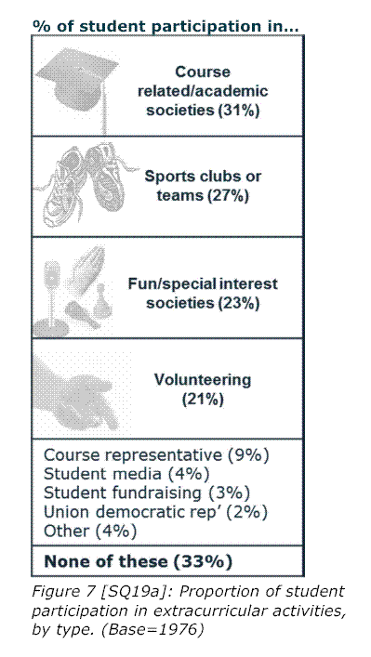
Nationally?
Decrease in decision importance – increase in uptake
Increase in all forms of societies in the past ten years
Recently a significant increase in Academic Societies – thought to correlate with the introduction of 9K fees

Slide 5
Swansea Specific?
33% of Swansea societies are academic of academically related.
Highest application rate of all categories
Sector leading for events and interaction rates

Slide 6
Anecdotal Evidence
“[The department] help us by providing rooms frequently, attending our networking events, supporting (small financial contribution) or events, and I meet with John (head of the law school) every couple of weeks. On the flip side we do a lot of work for the school, and a number of the competitions we enter benefit their reputation.” LAW SCIETY
“one or two lectures are keen 99% of the time and have asked us to organise dissertation workshops which we are working with them to sort out” AMERICAN STUDIES SOCIETY
“ We would like to work with [the department] on educational trips, and work experience opportunities.” PSYCHOLOGY SOCIETY
“The department is fantastic. I am invited to the student staff consultative meetings which is where I can take any issues I have. They have also supplied us with considerable funding. The college send out some of our emails to all the students to advertise our events.” BIOCHEMISTRY & GENETICS SOCIETY
“The German department is absolutely amazing for the society. It helps a lot, and even comes up with ideas for events.” GERMAN SOCIETY

Slide 7
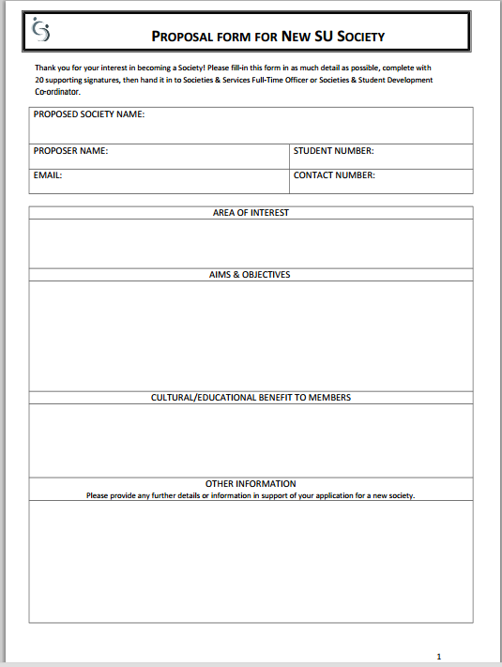
The Future
New societies form –
Information and 20 signatures
Subject reps
Societies Executive

Slide 8
The Future
Already established societies need as much help, encouragement and engagement as new ones!
Try to meet regularly with the committee, invite the committee to sit on departmental meetings
Seek Funding
Think of new ideas & opportunities
E.g. Bar Soc suggested coaching, training and mentoring – all disciplines.

Slide 9
References
NUS, Success in the Student Market 2013
Swansea University Students’ Union MSL Stats 2014
NUS, Student Opportunities Lunch and Learn Webinar 2013

