Slide 1


Slide 2

Introduction to the Fundamentals of Nursing Practice – Assessment through OSCE
David Gallimore
Senior Lecturer, CHHS

Slide 3
Outline of presentation
Why?
What did we do?
How did we do?

Slide 4
Pre Registration BSc Nursing
Approximately 800 students in total
3 year course – 2 intakes/year, campus in Carmarthen
50% theory, 50% practice
Bachelor of Science degree and NMC registration
These students are 8 weeks into course, haven’t been on clinical placement

Slide 5

Patient Safety
In one year there are 3,283 hospital in-patient deaths through preventable error, another 7,000 suffer severe harm
Equivalent to 9 medium size aircraft (Boeing 737/Airbus A320) being written off with total loss of life every year……
…..in the UK!
(1000 Lives plus)

Slide 6

NATIONAL CONFIDENTIAL ENQUIRY into PATIENT OUTCOME and DEATH (NCEPOD) report 2005
Inconsistent recognition of physiological instability
Respiratory rate was infrequently recorded.
Inconsistent action

Slide 7
NATIONAL CONFIDENTIAL ENQUIRY into PATIENT OUTCOME and DEATH (NCEPOD) report 2012
“Time to Intervene”
Advisors considered that warning signs for cardiac arrest were present in 344 out of 462 (75%) of cases.
These warning signs were recognised poorly, acted on infrequently, and escalated to more senior doctors infrequently.

Slide 8
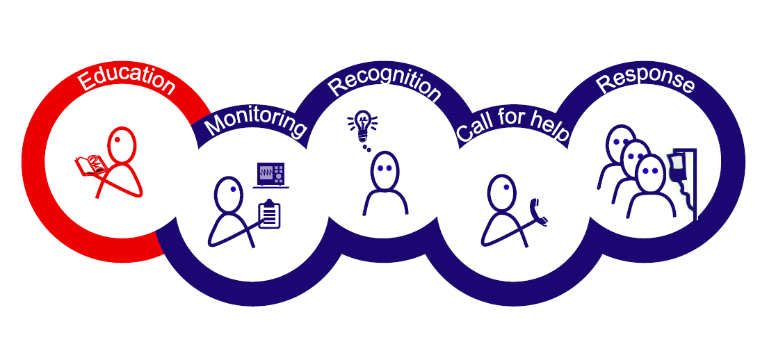
Chain of prevention
Smith, G.B. (2010) In-hospital cardiac arrest: Is it time for an in-hospital ‘chain of prevention’? Resuscitation, Volume 81, Issue 9, 2010, 1209 - 1211

Slide 9

Nurse Education
The Essential Skills Clusters (NMC 2007,2010) clearly state that students should be able to recognise and respond appropriately to a deteriorating patient and/or emergency situation.

Slide 10
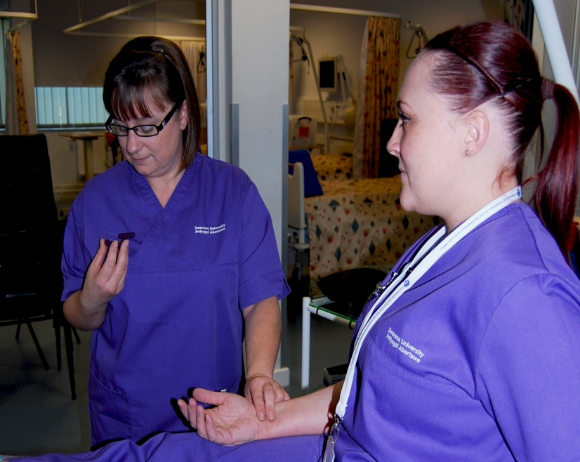
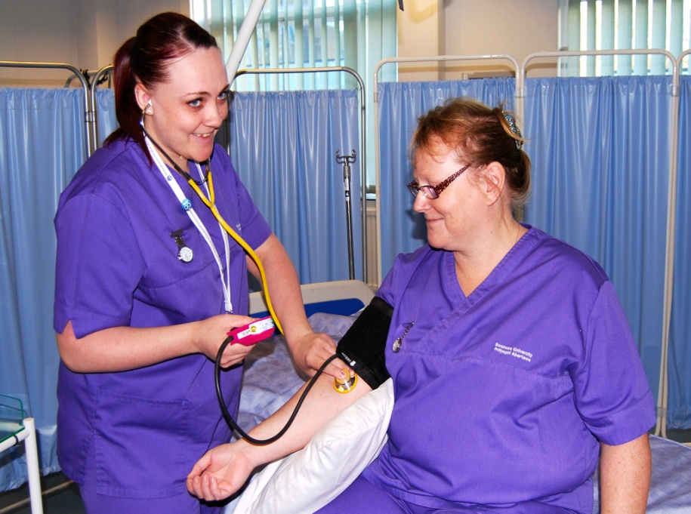
Recognising Sick Patient Teaching Day

Slide 11
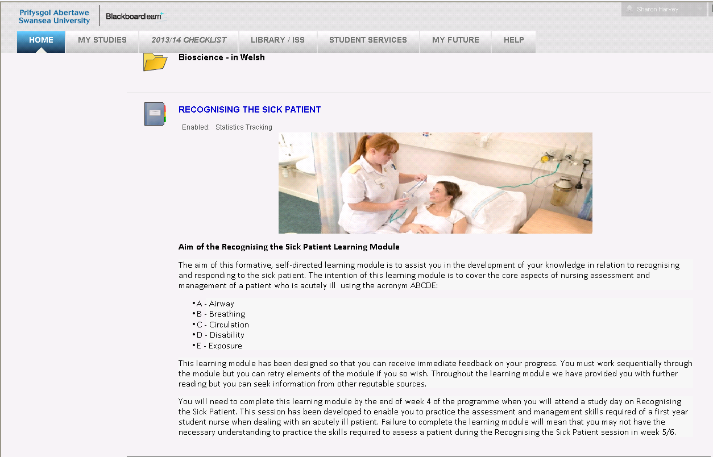
Blackboard Learning Module

Slide 12
Usage
95% of students have used the learning module since it has been introduced.
Average number of times accessed per student = 28
Overall number of times accessed by all cohorts = 14656

Slide 13
Evaluation
Poor student engagement in practical skills
Students lacking in confidence
Feedback from clinical staff
Are our students able to competently assess basic physiological changes in patients?

Slide 14


What is an OSCE?

Slide 15
OSCEs
Developed in the UK in the 1970’s
Specifically designed to assess clinical skills in medical students
Currently OSCEs are increasingly being considered for assessing clinical competence in nursing, midwifery and allied health curricula
Numerous studies have identified the validity and reliability of OSCEs as an assessment strategy
Accepted assessment strategy worldwide

Slide 16
Recognising Sick Patient Formative OSCEs
All student must be aware of the importance of passing OSCEs before going out into practice
Test doing the following activities:
  Station 1: Hand-washing
  Station 2:Respirations,Pulse,Temperature
  Station 3:Blood Pressure
Pass mark for Hand-washing is 100%
Pass mark for the other two stations are 75%

Slide 17
On day of OSCE
Students allocated into groups
Student takes turns as “patient”
Wait in reception area (PC lab)
On Blackboard there are a number of resources:
  Student handbook for OSCEs
  Information on the process for the OSCE
  Marking criteria for the OSCEs

Slide 18
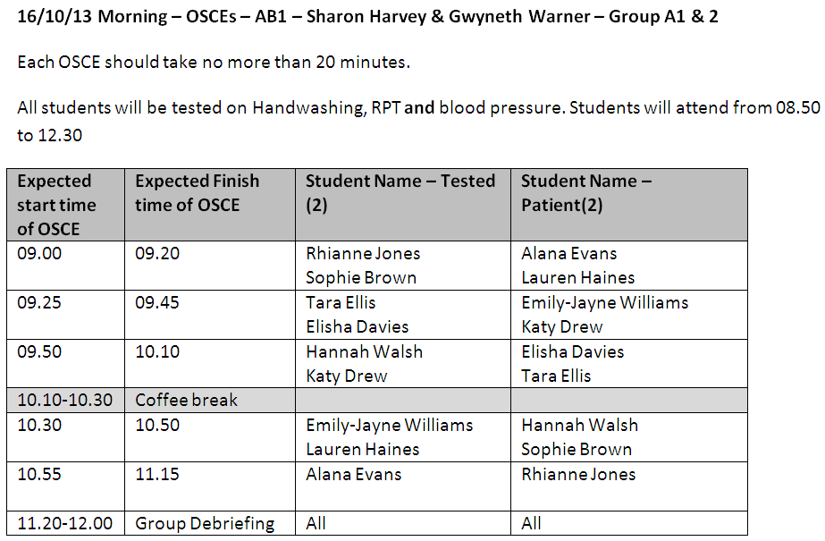

Slide 19
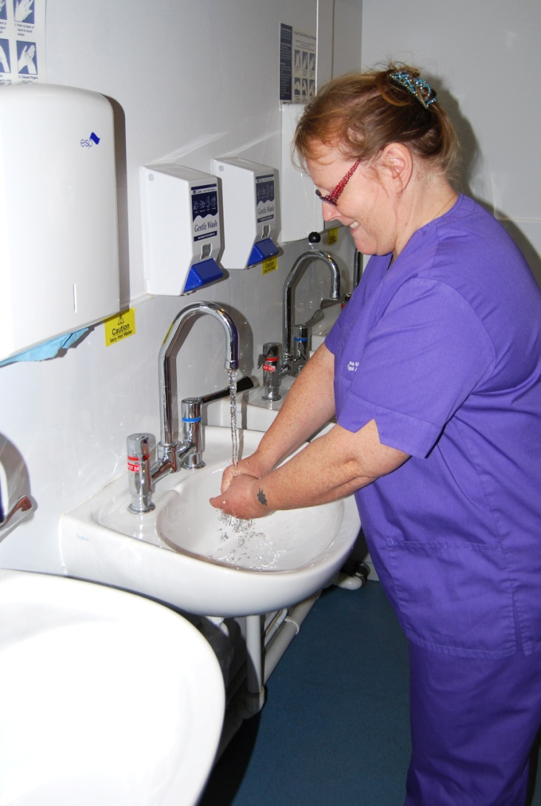
Handwashing

Slide 20
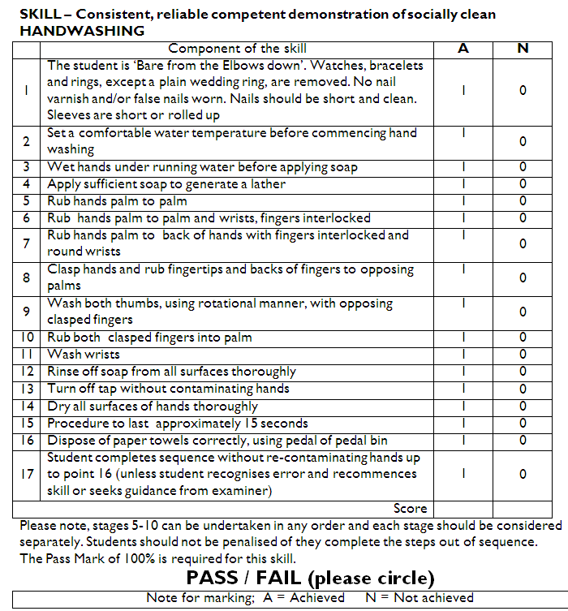

Slide 21

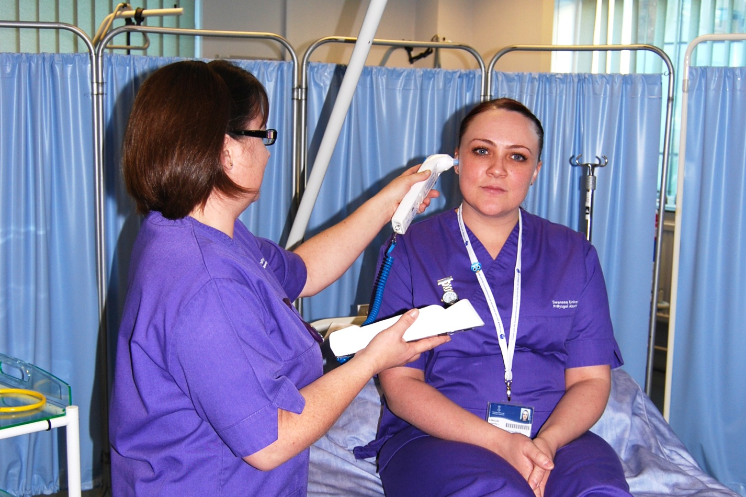
Pulse/Respirations and Temperature

Slide 22
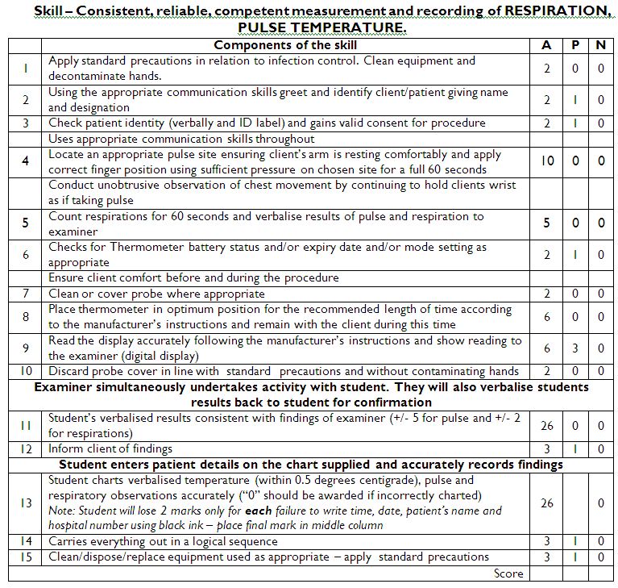

Slide 23

Blood Pressure

Slide 24
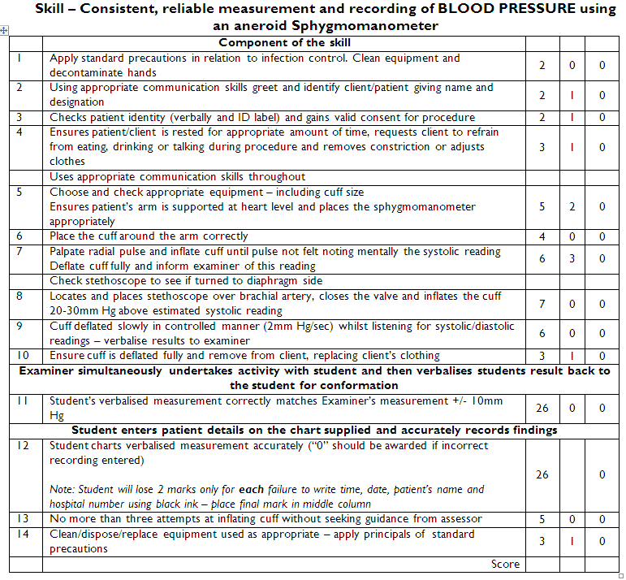

Slide 26
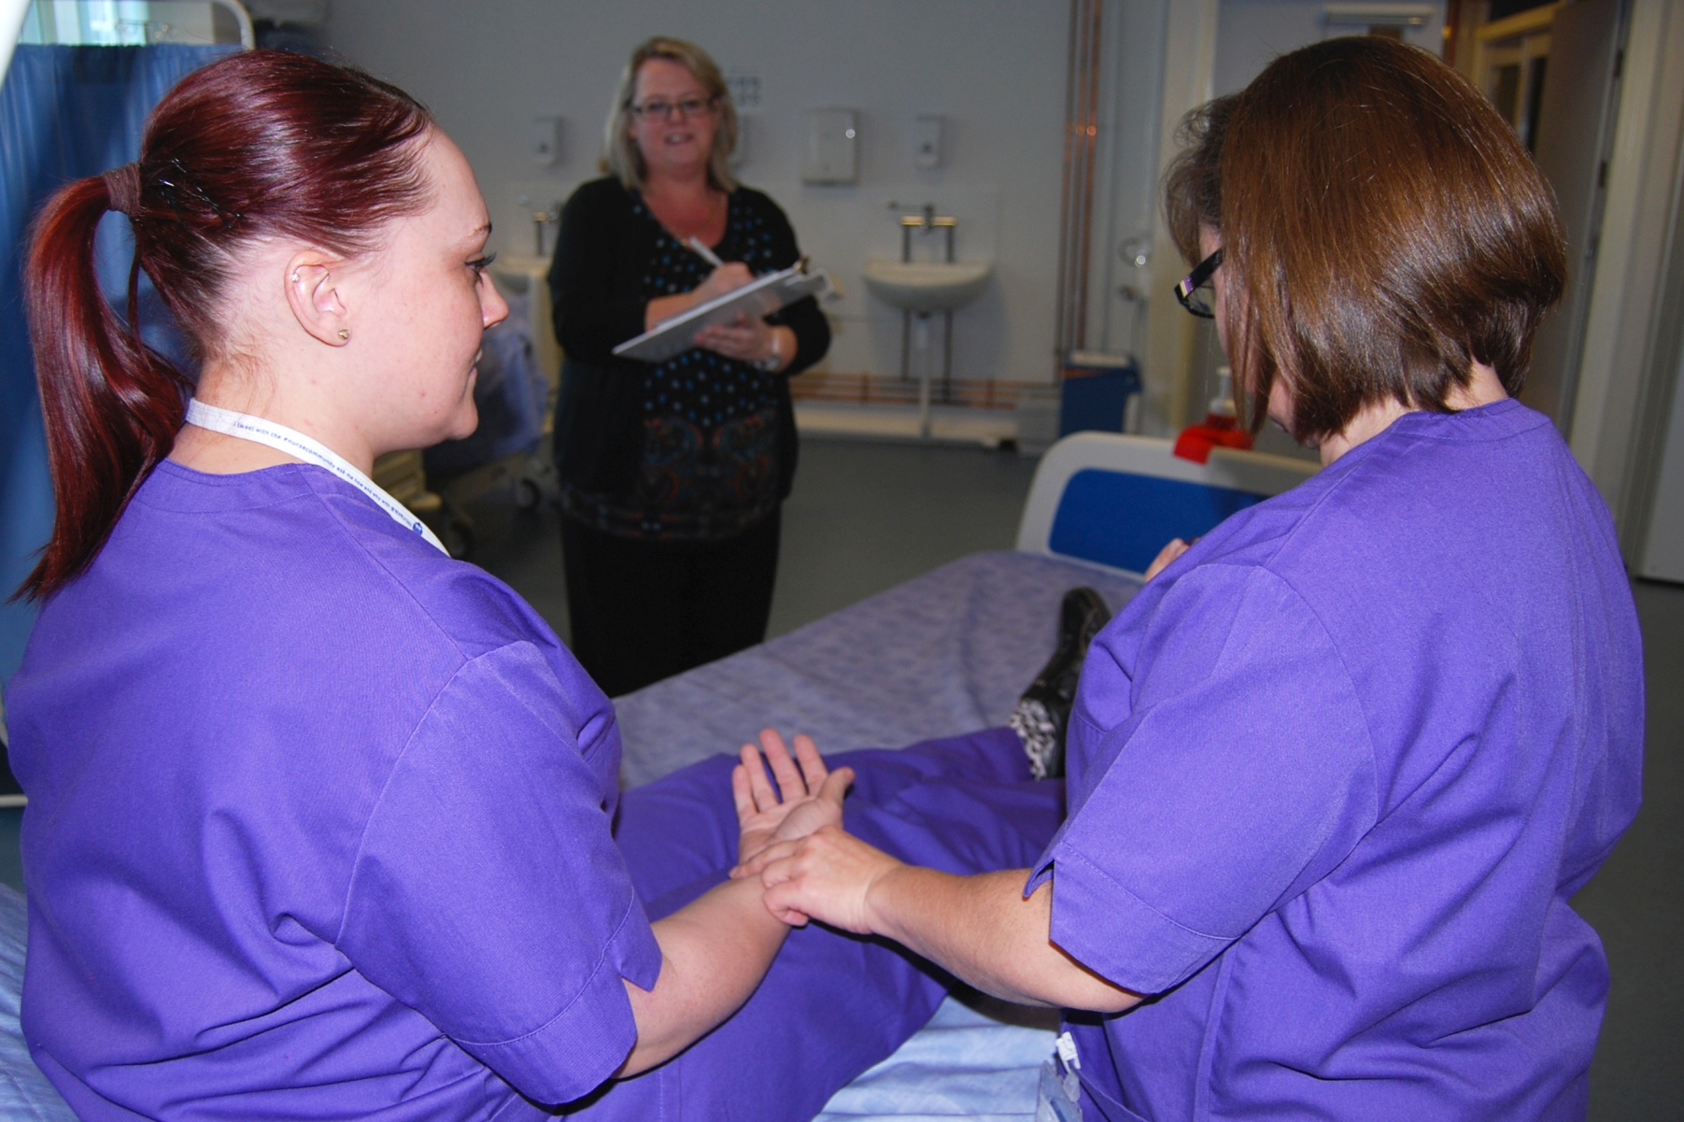
Assessment

Slide 27
Results of Formative OSCEs
94% passed hand-washing on first attempt – all retrieved at second attempt.
87% passed Respirations, Pulse & Temperature on first attempt – all retrieved at second attempt.
95% passed blood pressure on first attempt – all retrieved at second attempt.

Slide 28
Student evaluations
The OSCE and clinical skills week enabled me to learn relevant skills
  Strongly agree; 67% (n=51) Agree; 33% (n=25)
The clinical skills week increased my confidence with my clinical skills
  Strongly agree; 71% (n=58) Agree; 29% (n=24)
I had enough time to practice before the OSCE
  Agree; 2% (n=2) disagree; 61% (n=50) strongly disagree; 37% (n=30)

Slide 29
Student Evaluation
“A very enjoyable way of learning”
“The most stressful thing I’ve ever done – but worthwhile”
“The blackboard learning module on recognising the sick patient was helpful”
“I enjoyed the OSCEs week it taught me a lot.”
“ It was good to know how to do observations properly especially as we are on placement very soon.”
“I found it a worthwhile and helpful week to prepare me for clinical practice.”

Slide 30
Summary
Recording changes in patient observations is an important element of patient safety.
This is a skill that should be taught to student nurses before they enter clinical practice
We are now confident that all our students are able to accurately and confidently perform these skills

Slide 31
References
Clarke, J. (2008). The ‘How to Guide’ for reducing harm from deterioration. London: Patient Safety First.
Smith, G.B. (2010). In-hospital cardiac arrest: Is it time for an in-hospital ‘chain of prevention’? Resuscitation, 81,1209-1211.

