Slide 1
The Higher Education Academy in Wales: A news and events update
Lizzie Badrick
Policy and Partnerships Officer (Wales & Northern Ireland)
March 2014

Slide 2
The Higher Education Academy
Works in partnership with HEIs, student bodies, academic and professional staff and sector agencies and funders.
Champions excellence in learning and teaching in higher education.
Committed to improving the student learning experience by:
raising the status of teaching
adding to the body of knowledge relating to pedagogy
enhancing professional teaching practice
facilitating networks and communities of practice.
http://www.heacademy.ac.uk/strategic-plan
The Higher Education Academy Strategic Plan 2012-2016
Notes:
The HEA launched its new Strategic Plan in 2012, which will take the organisation through to 2016
This is a dynamic strategy that we will regularly review so that we remain flexible and proactive in meeting the needs of the higher education community, and in developing new business at home and internationally.
As champions of excellence in learning and teaching, and as a national body for enhancing learning and teaching in higher education throughout the UK, our strategic priorities directly reflect that sentiment:
to inspire and support effective practice in learning and teaching;
to recognise, reward and accredit excellent teaching;
to influence policy, future thinking and change;
to develop an effective, sustainable organisation that is relevant to, and valued by, higher education
We are committed to improving the student learning experience by;
raising the status of teaching
adding to the body of knowledge relating to pedagogy
enhancing professional teaching practice
facilitating networks and communities of practice.

Slide 3
The HEA in Wales
Responding to the distinctive needs of higher education in Wales, whilst recognising the importance of sharing across the UK higher education sector, we undertake a variety of learning and teaching enhancement work.
In Wales the HEA works in partnership with Welsh higher education providers and key sector organisations to support the development of policy and enhance practice in relation to learning and teaching in higher education.

Slide 4
The HEA in Wales
Events
Funding
Groups
Welsh Institutional Group (WIG)
Education for Sustainable Development and Global Citizenship (ESDGC) group
Wise Wales
Sector-wide collaboration
Future Directions for Higher Education in Wales
Resources
Thematic
Disciplinary
Notes:
Events: A wide range of HEA events run in Wales. Highlights in 12/13 included Future Directions Events, such as Future Directions for Skills and Employability (held in collaboration with QAA & HEFCW), the first HEA Wales Learning & Teaching Summit, and a wide range of new to teaching workshops, subject specific and thematic events.
Funding: HEA Funding opportunities include; TDG’s (a bid-based development grant funding exists to stimulate evidence-based research and encourage innovations in learning and teaching that have the potential for sector-wide impact. Grants are awarded on an individual, departmental or collaborative basis, the International Scholarship Scheme (designed to benefit the UK HE sector by bringing back interesting, challenging and innovative teaching practice to UK), Doctoral Programme (which enables focused long run study to be carried out within a well-supported environment). Research Projects, workshop and seminar series. From time to time, the HEA offers funding to support Welsh projects and initiatives. To keep in touch with the latest Welsh opportunities, you can subscribe to the HEA Wales bulletin.
Groups: An example of some of the groups we co-ordinate / are involved with.
Resources: Visit the HEA website to find out more,

Slide 5
Future Directions for Higher Education in Wales
A collaborative quality enhancement programme involving higher education providers and key sector agencies in Wales. The HEA plays a co-ordinating role:
facilitating and supporting group meetings
delivering funding for work-strand events, publications and campus activities
discussion of FD work with WIG, Jisc, HEW L&T advisory group, HEFCW, QAA and NUS Wales

Slide 6
Graduates for Our Future
3 Workstrands: Learning for Employment, Learning in Employment, Students as Partners.
Achievements:
April 2012 Publication of case studies for each work-strand
April 2012 Inaugural Future Directions national conference at Glyndŵr University.
November 2012 Students as Partners in Practice event at Glamorgan University
May 2013 Future Directions for skills and employability event at Glamorgan University
May 2013 Publication of lessons learned guides for the work-strands
Notes:
GOF: The first Future Directions Quality Enhancement theme. Developed in response to the Welsh Government paper: For Our Future: The 21st Century Higher Education Strategy and Plan for Wales. The project is co-ordinated by the Higher Education Academy in Wales.

Slide 7
Global Graduates: Enabling Flexible Learning
A new Future Directions Quality Enhancement theme.
Launch: Future Directions Conference 2014: Global Graduates: Enabling Flexible Learning 2-3 April, Aberystwyth University. Book on at: http://www.heacademy.ac.uk/wales/future-directions-conference/2014-venue-and-booking
3 new work strands: Distinctive Graduates, Inspiring Teaching, Learner Journeys.
Notes:
FD Conference: come along.

Slide 8
HEA annual L&T conferences
HEA STEM Cluster Annual Conference Enhancing the STEM Student Journey 30 April-1 May, University of Edinburgh
HEA Social Sciences Cluster Annual Conference Teaching forward: the future of the Social Sciences 21-22 May 2014, Birmingham
HEA Arts and Humanities Annual Conference Heroes and monsters: extra-ordinary tales of learning and teaching in the arts and humanities 2-4 June 2014, The Lowry, Salford Quays, Manchester
HEA Annual Conference Preparing for learning futures: the next 10 years 2-3 July 2014, Aston University, Birmingham
http://www.heacademy.ac.uk/events
Notes:
Focussing on Events because a lot of funding calls have now closed. Here are some UK events that may be of interest!
HEA STEM Cluster Annual Conference Enhancing the STEM Student Journey 30 April – 1 May, University of Edinburgh
The conference will include keynote presentations, debates, individual papers, posters, and student poster competitions. Our keynotes will include Andy Field, Professor of Child Psychopathology at the University of Sussex, Dame Wendy Hall, Professor of Computer Science at the University of Southampton and Nike Folayan, Chair of AFBE-UK.
HEA Social Sciences Cluster Annual Conference: Teaching forward: the future of the Social Sciences, 21 - 22 May 2014, Birmingham
HEA Arts and Humanities Annual Conference Heroes and monsters: extra-ordinary tales of learning and teaching in the arts and humanities 2-4 June 2014, The Lowry, Salford Quays, Manchester
Our 3rd annual conference invites you to explore the everyday business of learning and teaching through metaphor and narrative, and so transfigure the ‘taken-for-grantedness’ of academic practice into fantastic tales of the unexpected.
HEA Annual Conference Preparing for learning futures: the next 10 years 2-3 July 2014, Aston University, Birmingham
The conference will focus on the future of the student learning experience and explore how we are preparing for it; it will look at how current policy and practice is (or is not) equipping us for the opportunities that lie ahead and what may need to be done to both adapt to and create new learning environments.

Slide 9
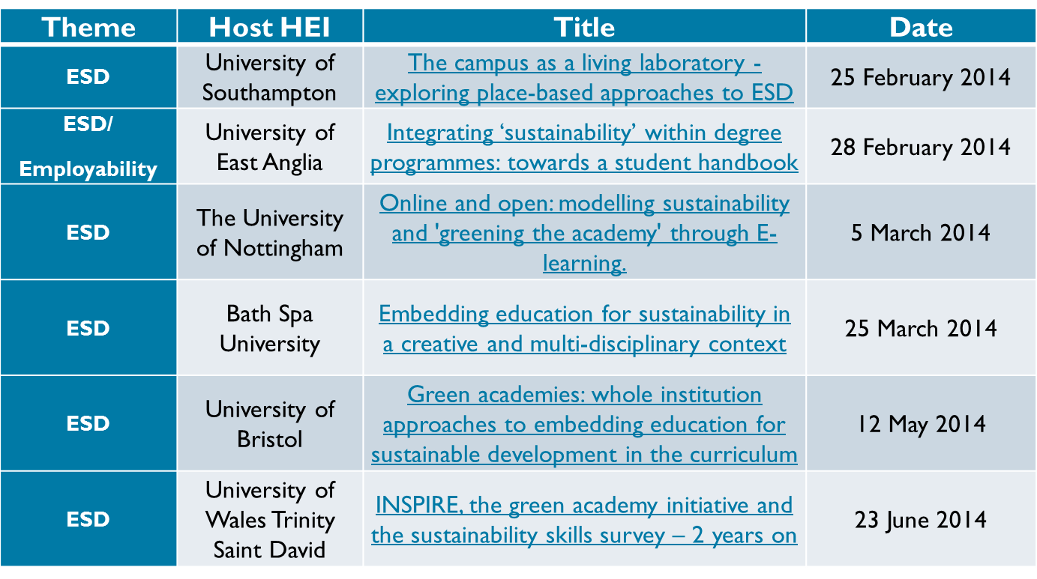
Workshop & Seminar series: Forthcoming seminars
Notes:
We provide UK subscribing institutions delivering Higher Education, the opportunity to promote research and evidence that has informed departmental and institutional policy and/or practice through our Workshop and Seminar Series
The HEA is running a workshop and seminar series in the thematic areas of employability, ESD, Green Academy, HEAR and internationalisation and within the discipline clusters of Arts and Humanities, Social Sciences and STEM.
Another seminars that took place in Wales in 13/14 include: The campus as a living laboratory - exploring place-based approaches to ESD, Cardiff University 12 Feb, and HEA STEM: Innovations in teaching and assessing large classes, Bangor University, 15 January.

Slide 10
Other HEA Events in Wales
New to using open access resources in teaching research methods, 19 March 2014, Radisson Blu Hotel, Cardiff.
Accreditation Information and Guidance Event, 20 March 2014, Cardiff University.
Fit for the workplace - Collaborative approaches to enhancing graduate employability in Sport, 1 May 2014, University of South Wales.
HEA STEM (Wales): Interdisciplinary Show Case, 22 May 2014, Cardiff University.
Notes:
The above represents a selection of Events that take place in Wales and across the UK. For all the latest updates sign up to the HEA Wales bulletin.

Slide 11
Enhancing employability: good practice in enterprise education.
Call for case studies!
In What?
The HEA is developing a new resource which aims to share good practice in enterprise education in HE across the disciplines and inform about support available in this area. We are seeking case studies of good practice in Enterprise Education, especially examples which demonstrate how enterprise education is embedded into the curriculum
Sign up:
Send an expression of interest to: employability@heacademy.ac.uk by Friday 4th April
Notes:
The HEA is developing a new resource which aims to share good practice in enterprise education in HE across the disciplines and inform about support available in this area. We are seeking case studies of good practice and particularly welcome examples which demonstrate how enterprise education is embedded into the curriculum. If you wish to share your innovative practice, please send us an expression of interest detailing:
Your name, role, institution;
Activity/practice: what it is and why it is innovative and/or offers something different;
How students are engaged;
Outcomes and evidence of impact.
The expression of interest should be no more than 1,000 words and should be emailed to employability@heacademy.ac.uk
by Friday 4 April 2014.

Slide 12
Keep in touch!
Email the HEA Wales team: Wales@heacademy.ac.uk
Follows HEA Wales on Twitter: @HEA_Wales
Website: Details of events, resources and funding: http://www.heacademy.ac.uk/wales
Wales bulletin: Sign up through My Academy http://www.heacademy.ac.uk/my_academy

