Slide 1
A B C
Learning Design @ Swansea University
Adapted from ABC workshop resources, ABC Learning Design, UCL. By Clive Young and Nataša Perović.
For additional information contact ABC LD team via
https://blogs.ucl.ac.uk/abc-ld/or tweet to @ABC_LD

Slide 2
Objectives
Summarise the ABC Learning Design methodology and process
List the six learning types
Produce a module information sheet and storyboard
Produce an action plan

Slide 3
Learning design is…
What does learning design mean to you?
How do you feel about learning design and why?
Share your thoughts with the person next to you
Share your thoughts with your group
Notes:
Think, pair, share activity
Link group feedback to ABC, especially with regards to solving some of the problems they face

Slide 4
What is ABC Learning Design?
Card and storyboard based approach to learning design
Pedagogically informed
Student focused
Collaborative
Engaging and hands-on

Slide 5
Notes:
Participants are not expected to create a complete module, patch or programme during an ABC workshop. Rather, they sketch out the module, patch or programme. The module, patch or programme is built in subsequent sessions with each other.

Slide 6
Laurillard’s Six Learning Types

Slide 7
Acquisition
Learning through acquisition is what learners are doing when they are listening to a lecture or podcast, reading from books or websites, and watching demos or videos.

Slide 8
Collaboration
Learning through collaboration embraces mainly discussion, practice, and production. Building on investigations and acquisition it is about taking part in the process of knowledge building itself.

Slide 9
Discussion
Learning through discussion requires the learner to articulate their ideas and questions, and to challenge and respond to the ideas and questions from the teacher, and/or from their peers.

Slide 10
Investigation
Learning through investigation guides the learner to explore, compare and critique the texts, documents and resources that reflect the concepts and ideas being taught.

Slide 11
Practice
Learning through practice enables the learner to adapt their actions to the task goal, and use the feedback to improve their next action. Feedback may come from self-reflection, from peers, from the teacher, or from the activity itself, if it shows them how to improve the result of their action in relation to the goal.

Slide 12
Production
Learning through production is the way the teacher motivates the learner to consolidate what they have learned by articulating their current conceptual understanding and how they used it in practice.

Slide 13
Activity 1: Module Information

Slide 14
Ancient and Medieval History
Roman Satire: Ranting and Bantering
Ian Gogh, Ian Repath
15 March 2019
Sex, violence and hypocrisy: How the Romans invented
satire.
X
Notes:
Review Session

Slide 15
Activity 2: Storyboard

Slide 16
Storyboard
Create an organisational structure

Slide 17
Roman Satire: Ranting and Bantering
Ian Gogh
15 March 2019
Induction
Weeks
2 - 4
Weeks
5 - 7
Week 8

Slide 18
Roman Satire: Ranting and Bantering
Ian Gogh
15 March 2019
Topic 1: Horace
Topic 2: Persius
Topic 3: Jevenal

Slide 19
Storyboard
Create an organisational structure
Sequence learning types to design your module

Slide 20
Conquest and Frontiers: England and the Celtic Peoples
Rees Davies
01 March 1999
Induction
Weeks
2 - 4
Weeks
5 - 7
Week 8

Slide 21
Storyboard
Create an organisational structure
Sequence learning types to design your module
Select activities and assessment

Slide 22
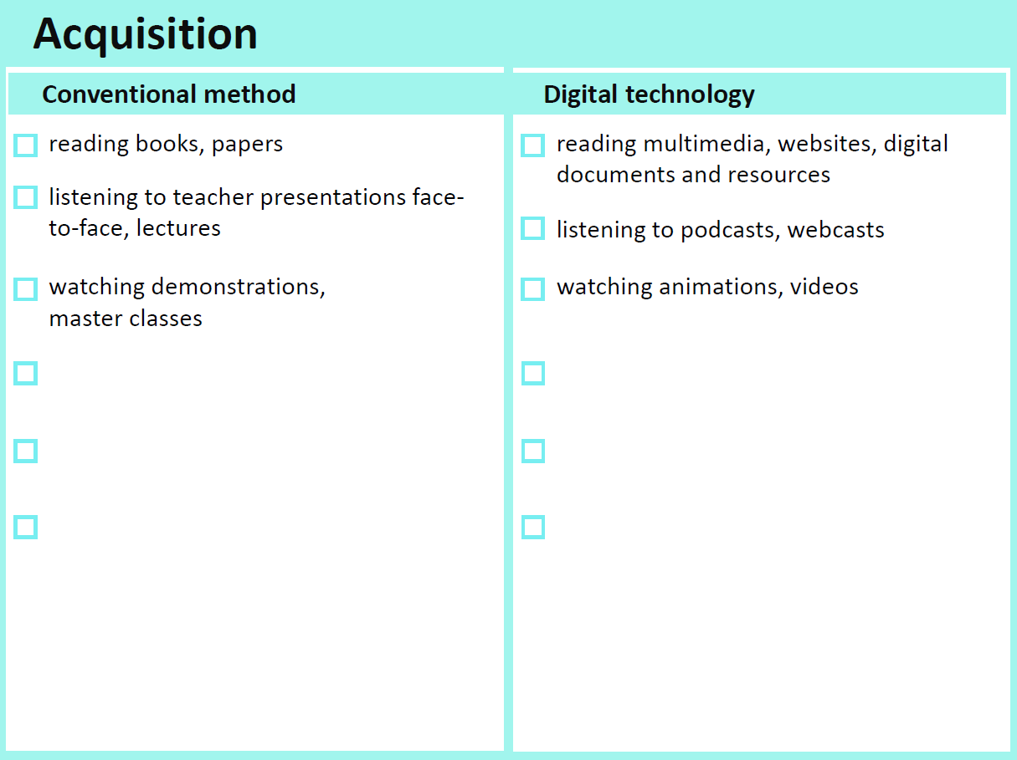
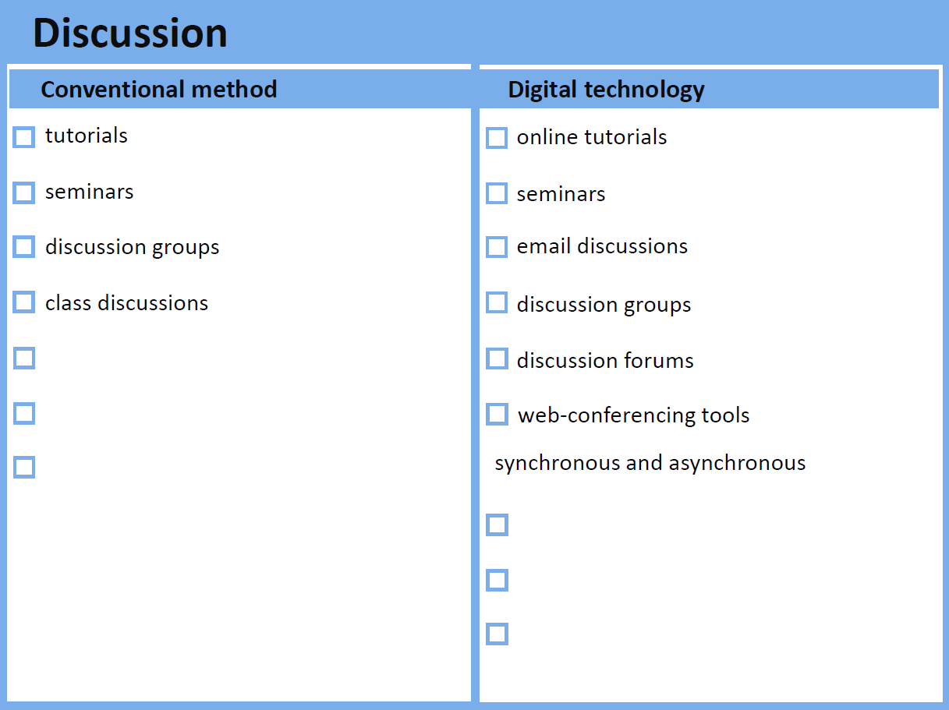
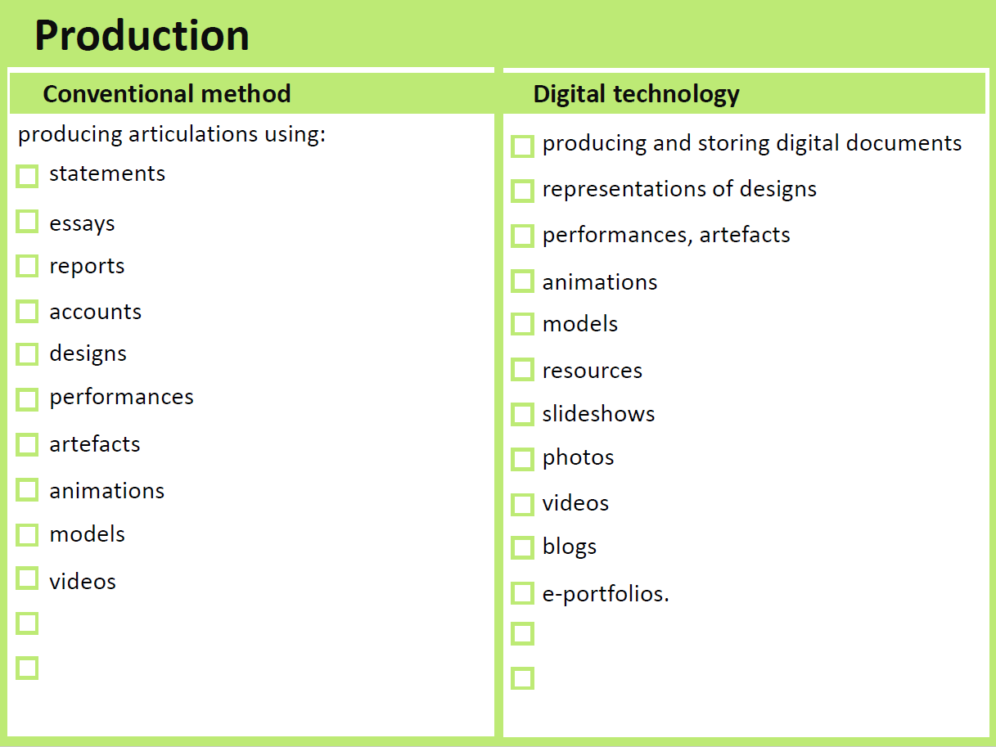
Conquest and Frontiers: England and the Celtic Peoples
Rees Davies
01 March 1999
Induction
Weeks 1 - 8

Slide 23
Choosing learning activities & Assessment

Slide 24
Choosing learning activities & Assessment
Interview Professor Davies

Slide 25
Choosing learning activities & Assessment

Slide 26
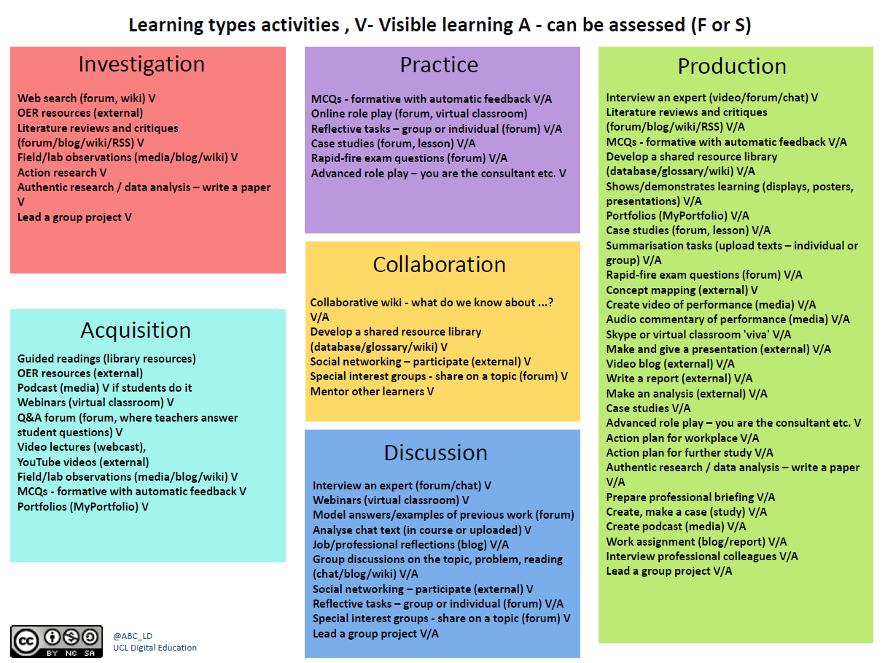
Choosing learning activities & Assessment

Slide 27
Roman Satire: Ranting and Bantering
Ian Gogh
15 March 2019
Weeks
1 -5
Weeks
6 - 8
Repeat
Project

Slide 28
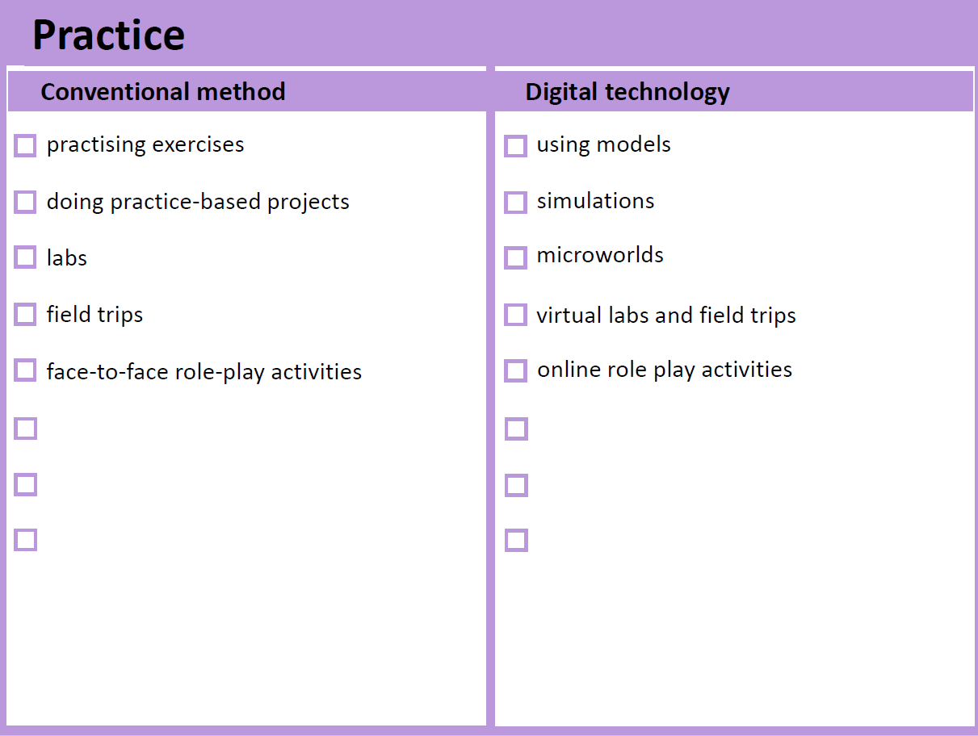
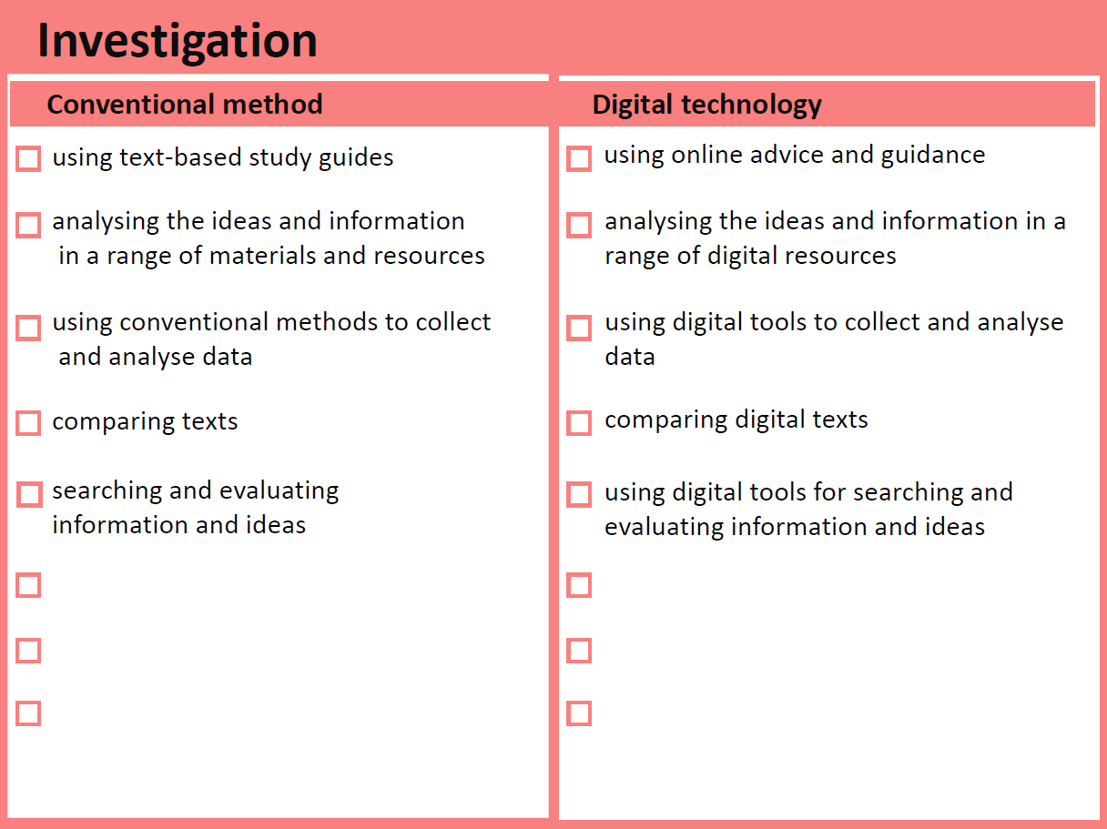
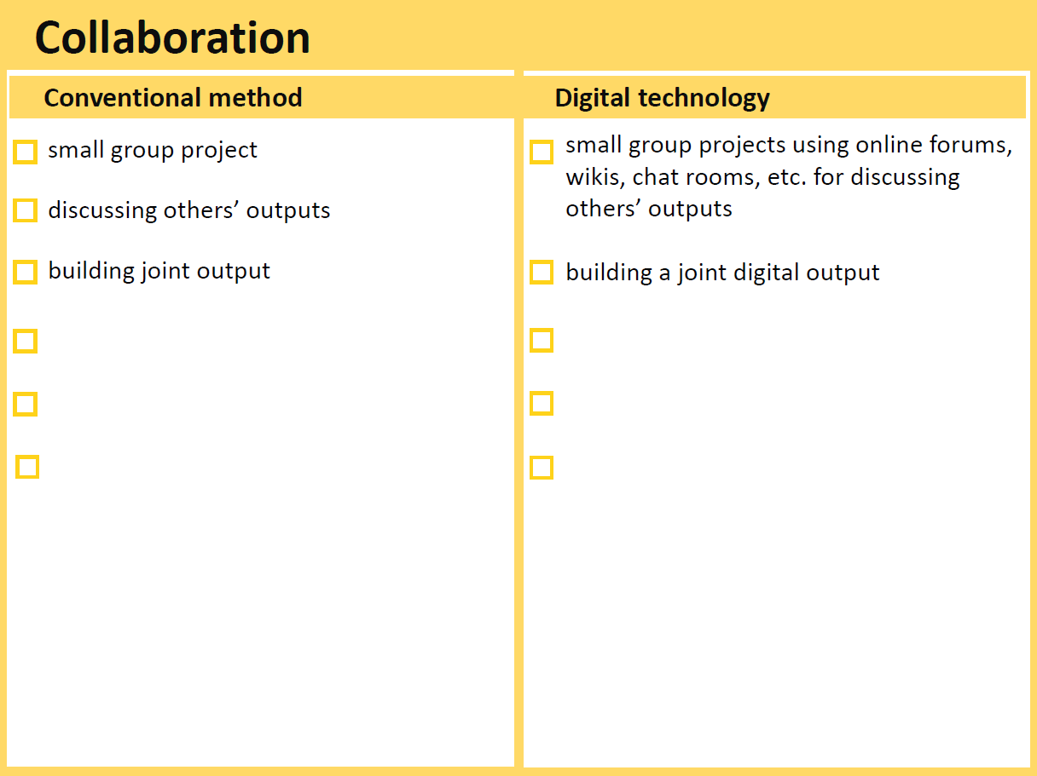
Roman Satire: Ranting and Bantering
Ian Gogh
15 March 2019
Weeks
1 -5
Weeks
6 - 8
Repeat
Project

Slide 29
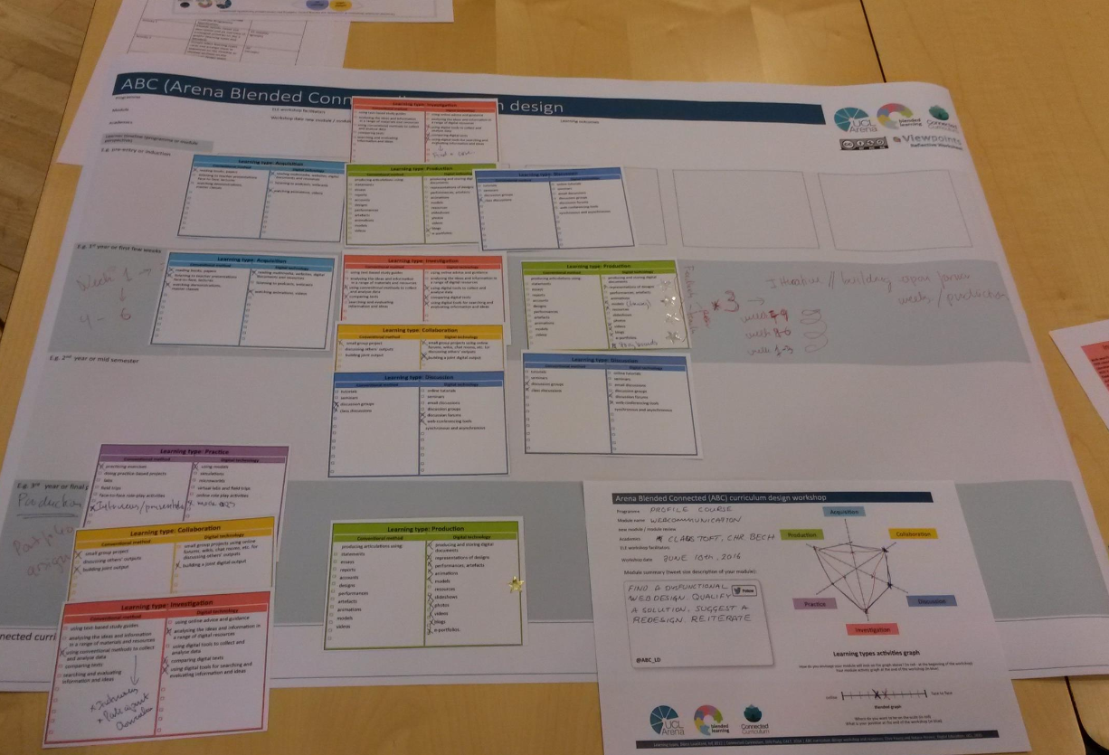
Infinite diversity in infinite combinations

Slide 30
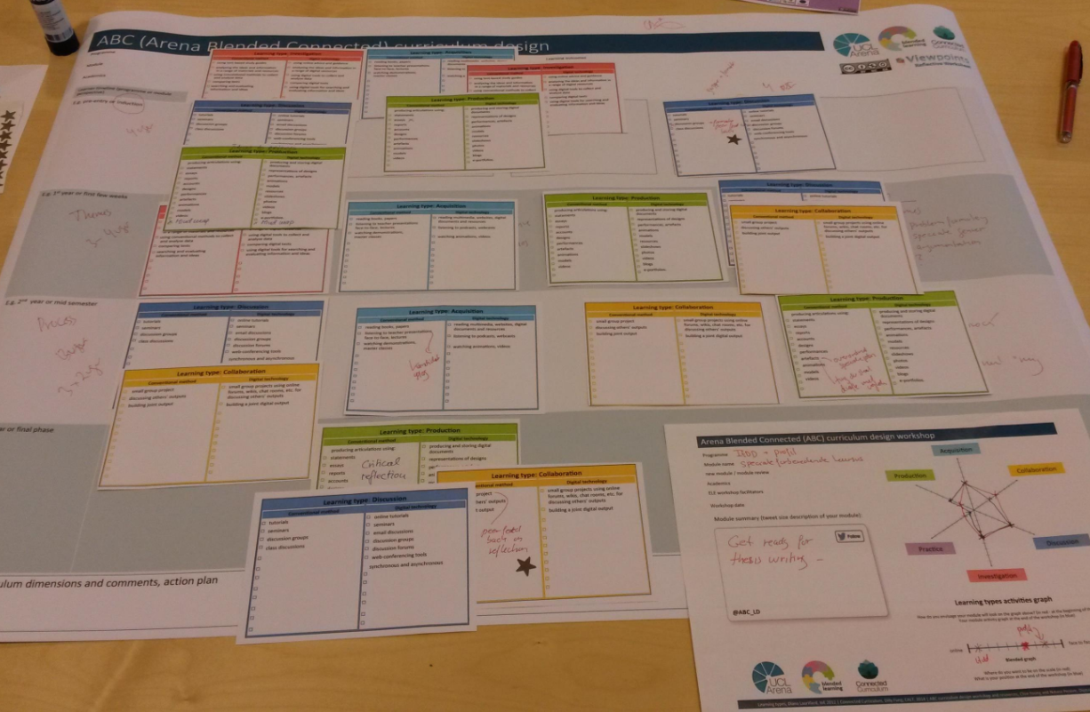
Infinite diversity in infinite combinations

Slide 31
Storyboard
Create an organisational structure
Sequence learning types to design your module
Select activities and assessment

Slide 32
Activity 3: Update Module Information

Slide 33
Ancient and Medieval History
Roman Satire: Ranting and Bantering
Ian Gogh, Ian Repath
15 March 2019
Sex, violence and hypocrisy: How the Roman invented
Satire.
X
X

Slide 34
Activity 4: Action Plan

Slide 35
Week 1 Acquisition and Collaboration activities to be decided | Jane Doe 31/10/2019
Project activies and rubric to be confirmed | John Smith 31/10/2019
Module team to meet to agree assessment | Jane Doe, John Smith, Andy Other 21/11/2019
Module team to attend programme review and present module | Jane Doe, John Smith, Andy Other 31/11/2019
All module material to be sent to Andy | Jane Doe, John Smith 15/12/2019
Canvas to be updated | Andy Other 22/12/2019
Notes:
Keep objectives SMART: Specific, Measurable, Achievable, Realistic, and Timely.
Must be completed before the end of the workshop
Important for allocating responsibilities – particularly if more than one colleague teaches on a module/ programme

Slide 36
Integration
Accessibility
Inclusivity
Learning and Teaching Strategy 2019 - 2024
Copyright
Digital Strategy
Employability
Professional Standards
United Kingdom Professional Standards Framework (UKPSF)
Canvas

Slide 37
Objectives
Summarise the ABC Learning Design methodology and process
List the six learning types
Produce a module information sheet and storyboard
Produce an action plan

Slide 38
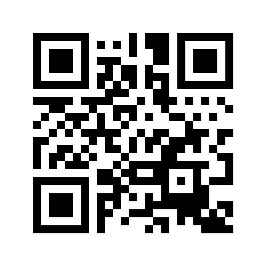
Share
Tweet pics tagging @abc_ld and @ susaltteam
Send us a picture of your storyboards and module information sheets
Take part in a case study
Complete the Feedback Form: http://bit.ly/SUABCFeedback

