Slide 1
A Selection of Story Boards
(From SALT and the Internet …)

Slide 2
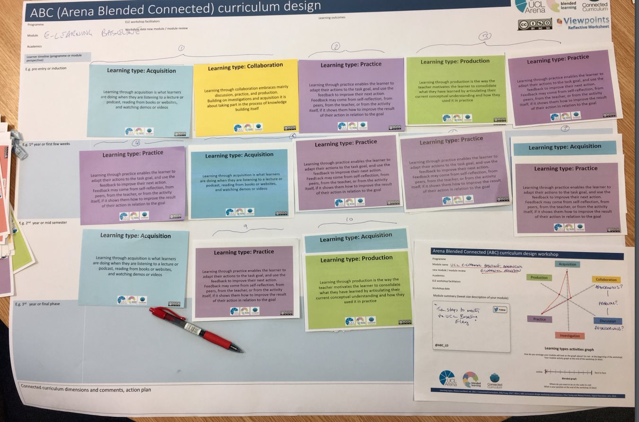
Storyboard 1 a)

Slide 3
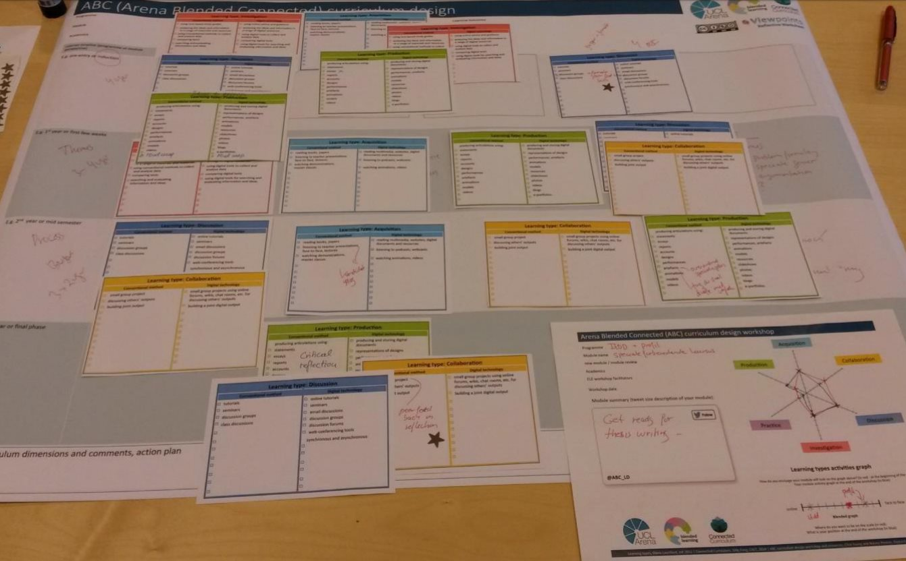
Storyboard 1 b)

Slide 4
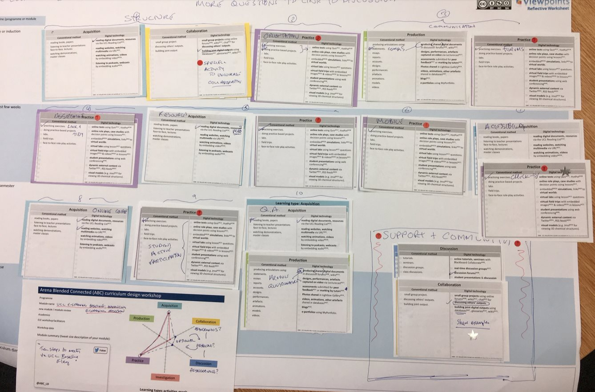
Storyboard 1 c)

Slide 5
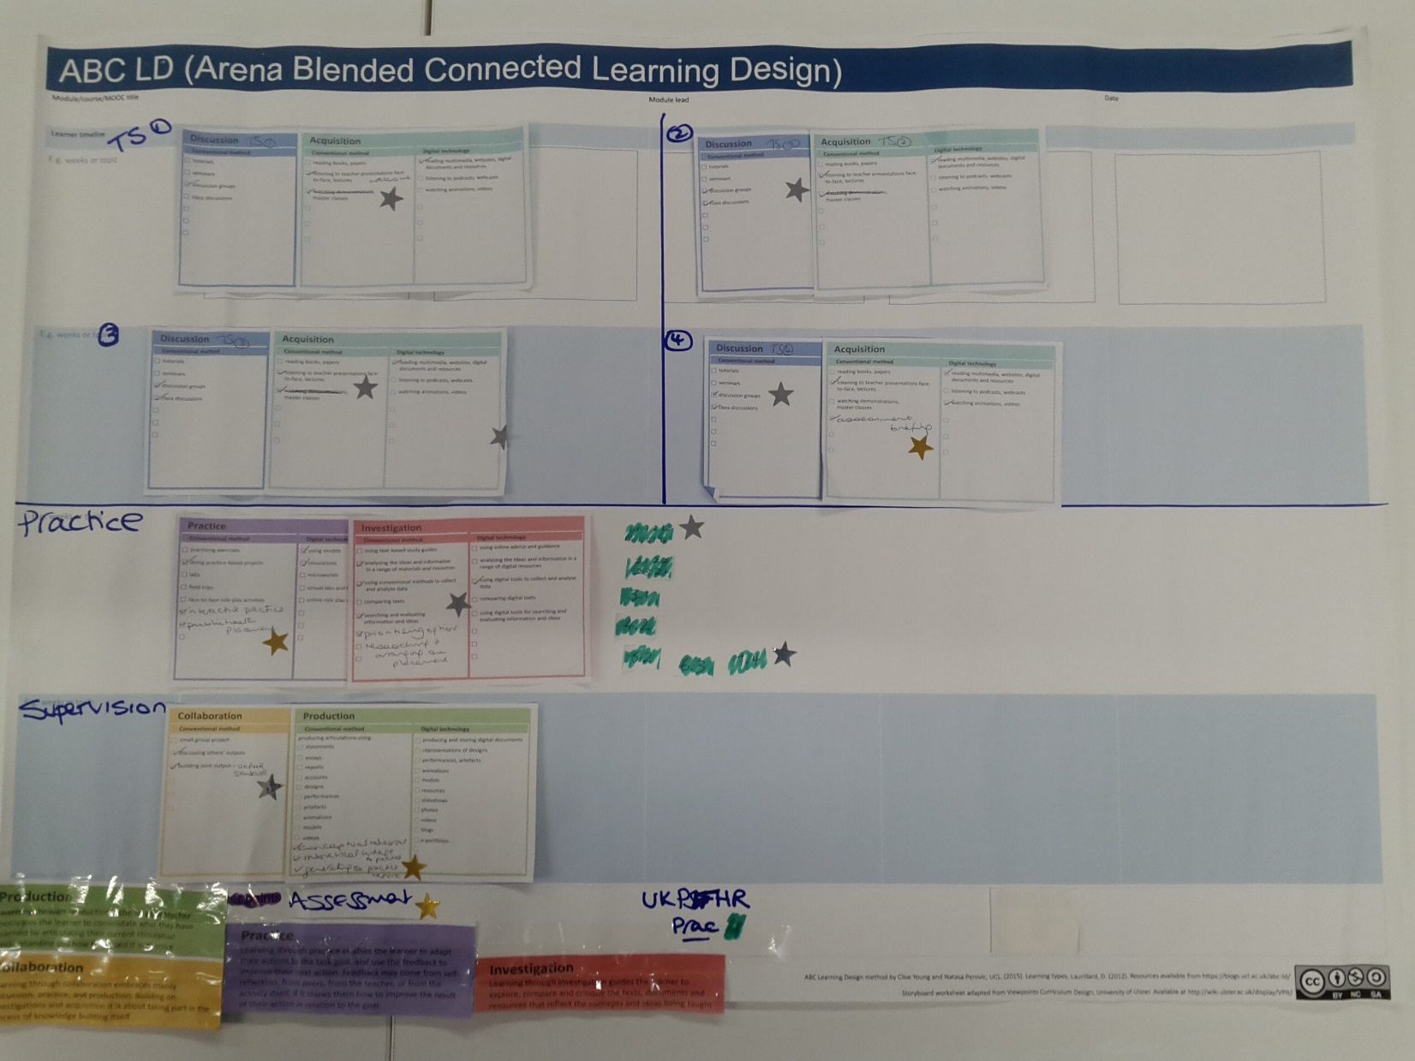
Storyboard 2 a)
(Prof Jane Thomas - SALT)

Slide 6
Storyboard 2 b)
(Prof Jane Thomas - SALT)

Slide 7
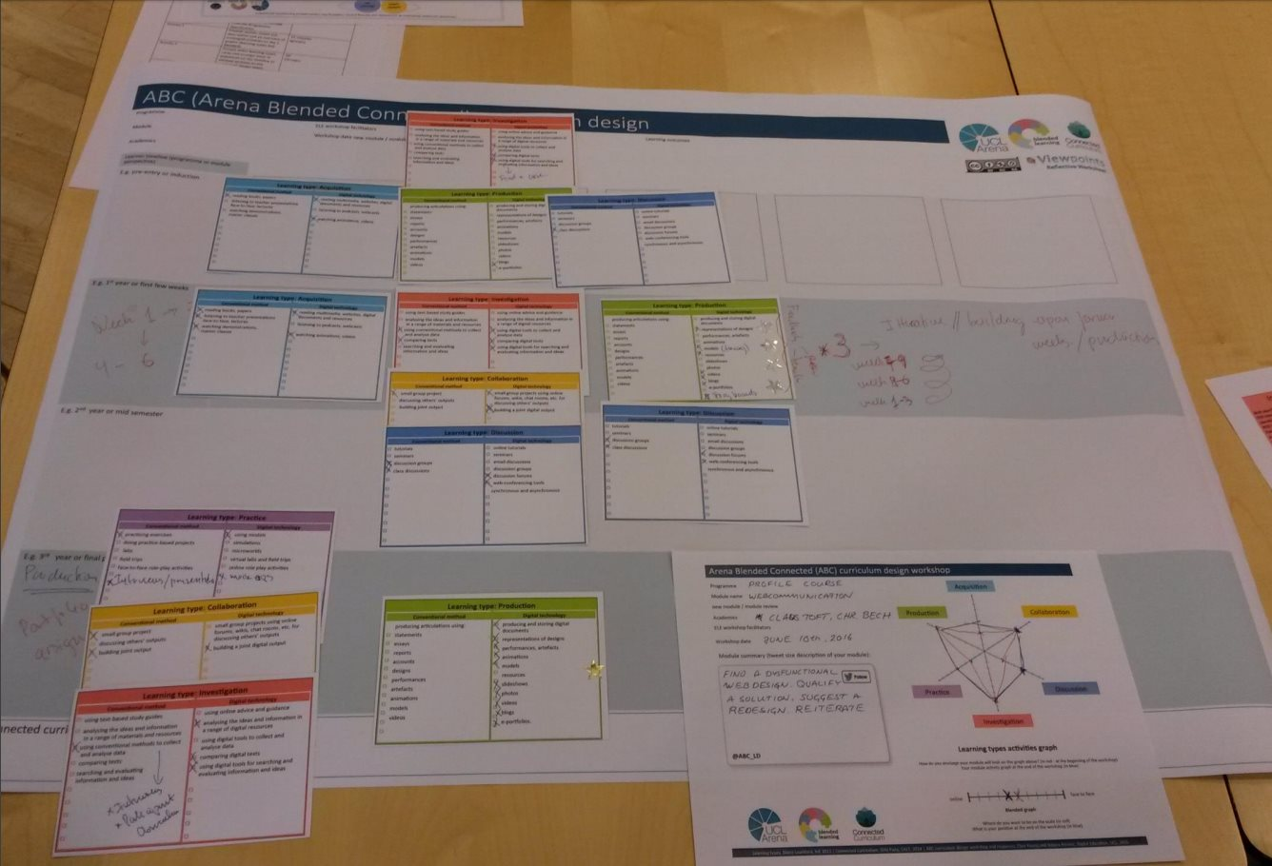
Storyboard 3

Slide 8
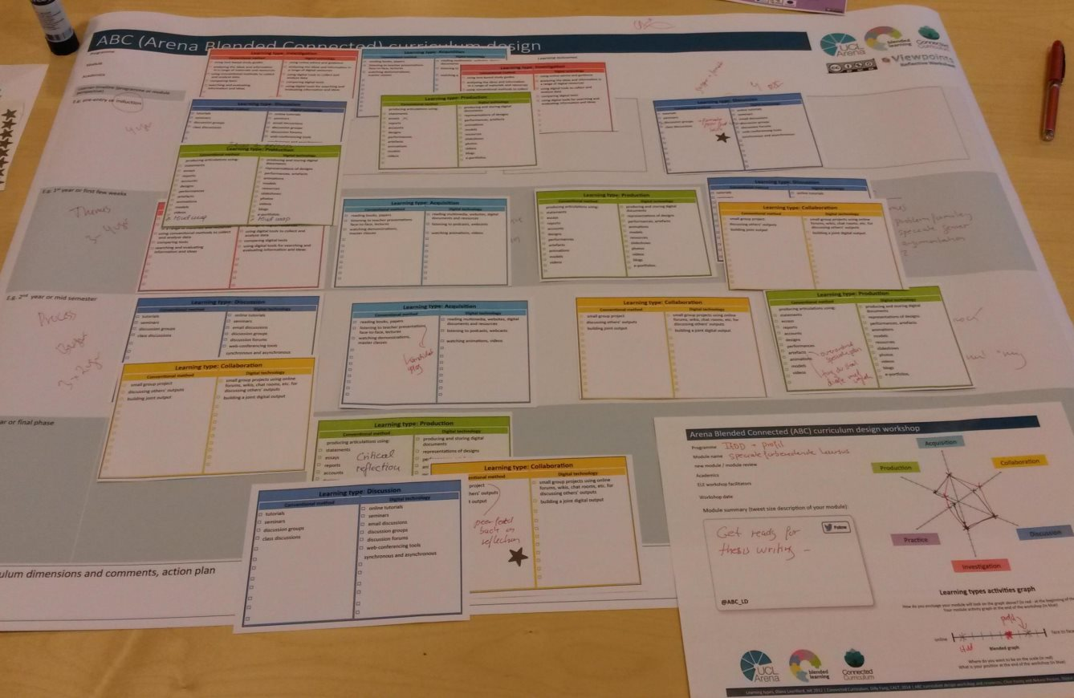
Storyboard 4

Slide 9
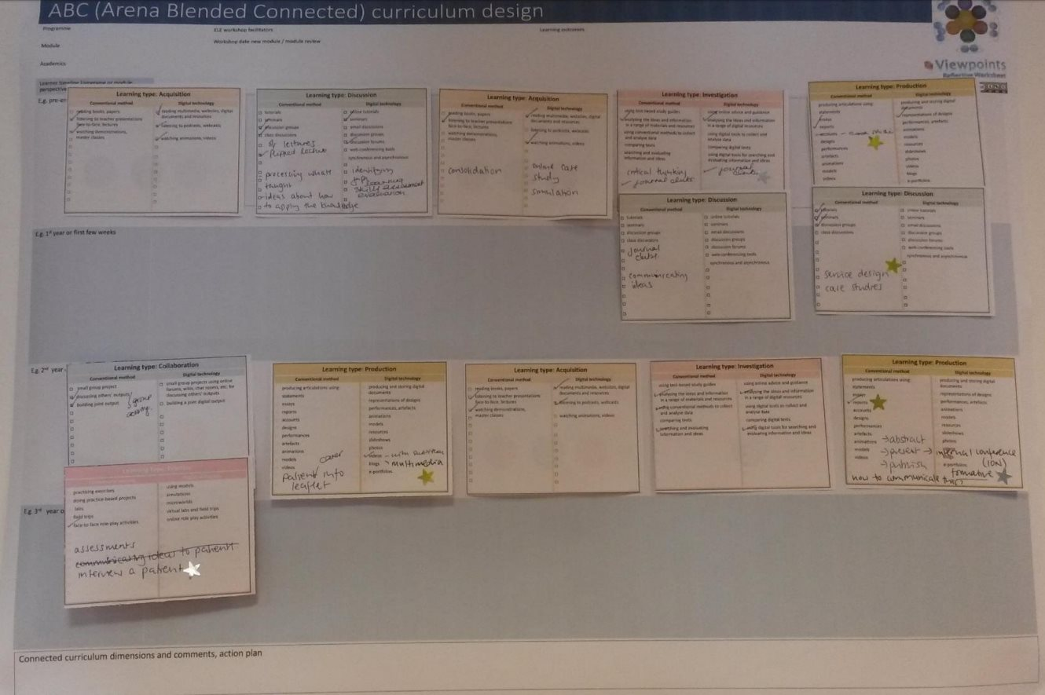
Storyboard 5

Slide 10
Storyboard 6 a)
(Matthew Allen - SALT)

Slide 11
Storyboard 6 b)
(Matthew Allen - SALT)

Slide 12
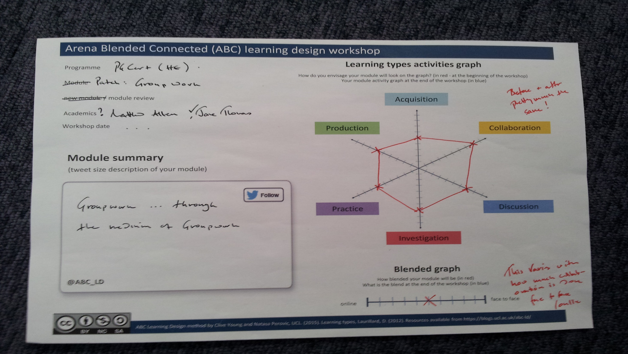
Storyboard 6 c)
(Matthew Allen - SALT)

