Slide 1
Zoom – The Basics for Engaging Teaching Welcome!

Slide 2
HIT RECORD!

Slide 3
SALT Supporting you in your teaching
salt@swansea.ac.uk
Rhian Ellis, Academic Developer, SALT
r.e.ellis@swansea.ac.uk
Suzanne Wells, Senior Academic Developer
s.m.wells@swansea.ac.uk

Slide 4
The Basics You can build with… SALT ‘Advanced’ SALT Zoom Workshops WVN support
The Focus today
1. Some introductory things…
2. Setting up, managing and sharing ‘Meeting’
links, with a view to ‘Hosting’ (teaching) with
Zoom
3. Engaging and interacting with students:-
Chat
Sharing mic & video (webcams)
Screensharing

Slide 5
cont…
4. Signpost to other ways of interacting
5. Briefly touch upon recording
Along the way ….some GDPR / security reminders

Slide 7
If you wish to stay on…
Quick recap & open mic at the end

Slide 8
1. Some ‘introductory’ things …
Device efficiency, variations
& connection
Background &
environment
Experience so far

Slide 9
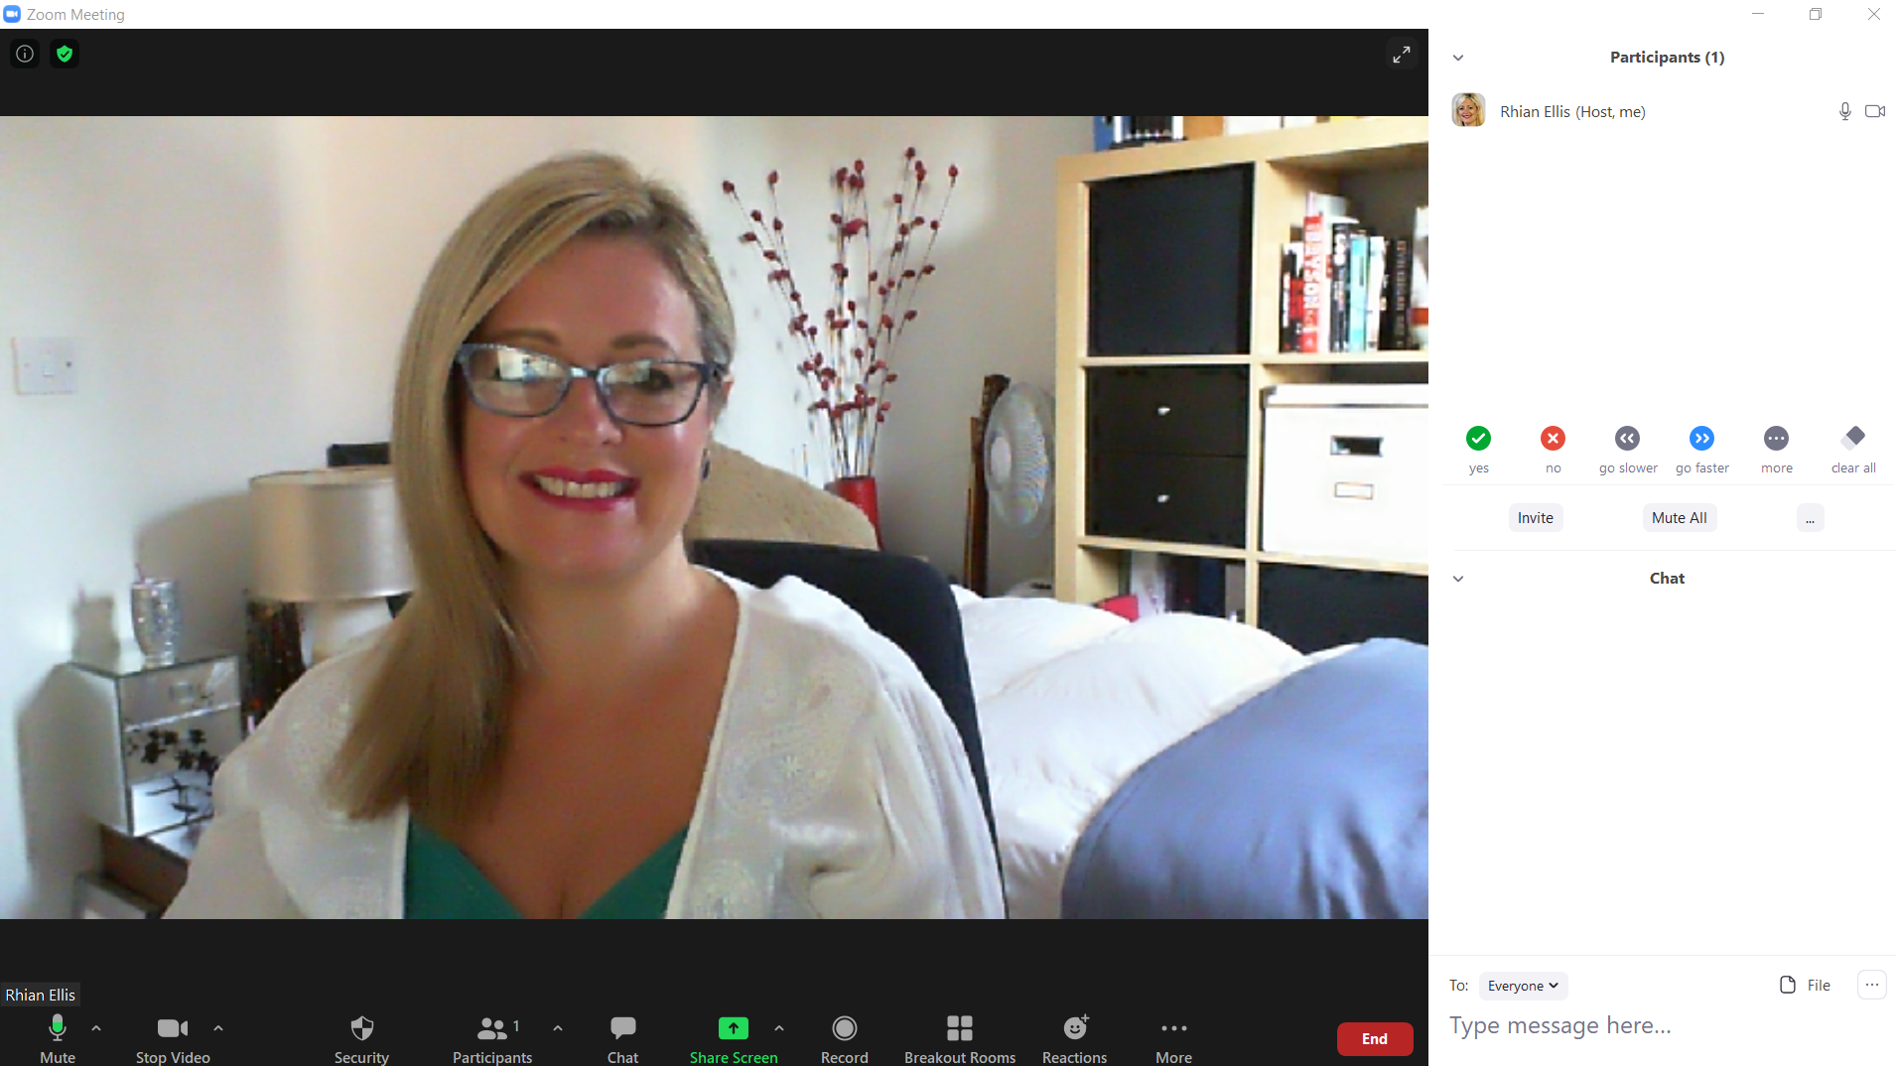

Slide 10
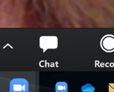
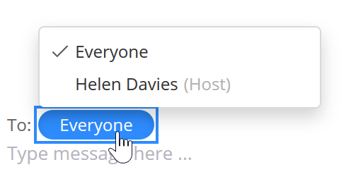
Text Chat pop out window

Slide 11
Q: What experience have you had with Zoom?
I’ve never used Zoom before today
I’ve been a ‘Participant’ in Zoom sessions before, but not ‘Hosted’
c) I’ve ‘Hosted’ a session or taught through Zoom, but not been a
‘Participant’ before
d) I’ve been a ‘Participant’ and a ‘Host’ in Zoom before
Notes:
.

Slide 12
Q: Have you used any similar tools to Zoom? Answer Y or N in chat If Y can you remember what?

Slide 13
2. Creating & sharing ‘Meeting’ links in your University account
1. The Zoom ‘Client’ desk top app
https://staff.swansea.ac.uk/it-services/zoom/
2. Outlook integration
3. Canvas and Panopto integration
4. Web version:
https://swanseauniversity.zoom.us/

Slide 14
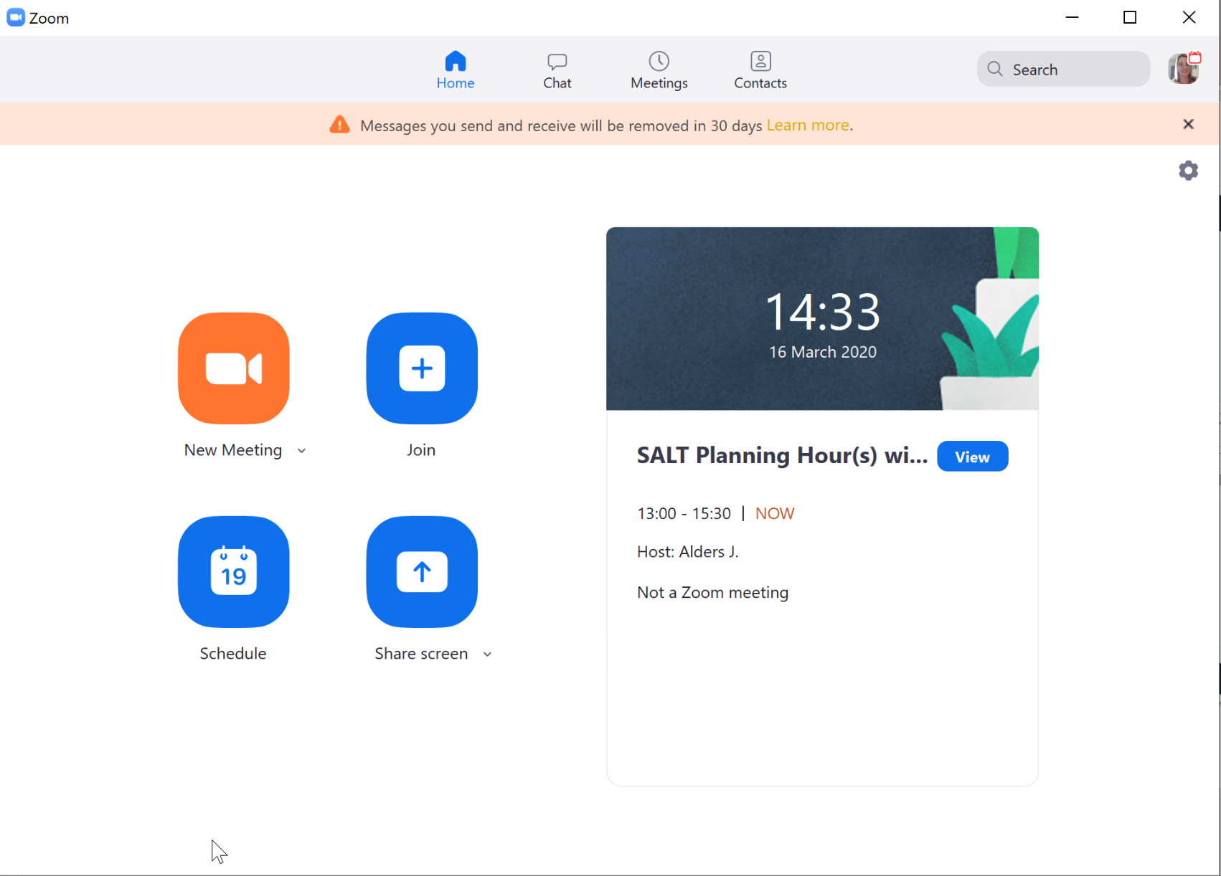
The Client app home screen looks like this…

Slide 15
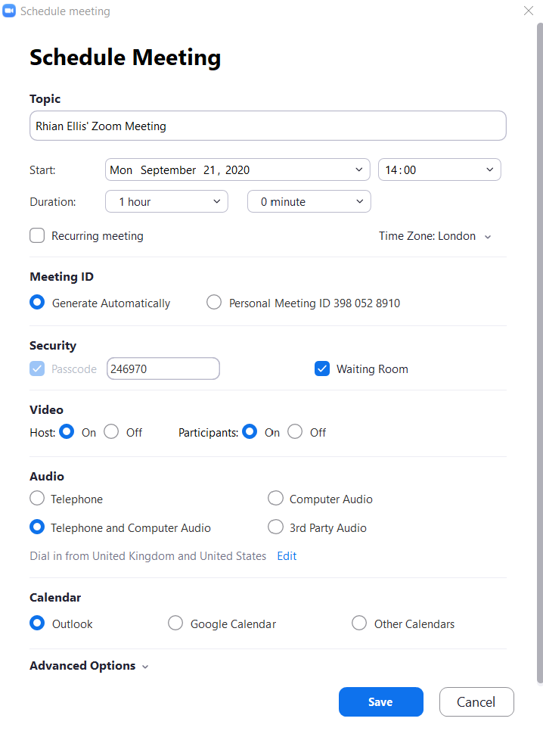
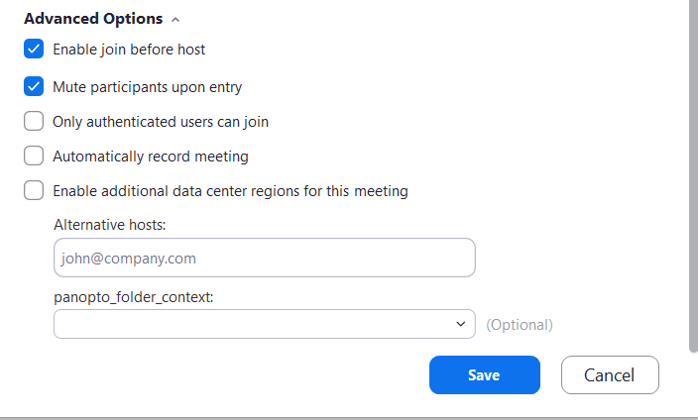

Slide 16
The ‘Set-Up’ Host
2. ‘Alternative’ Host
n.b. ‘Scheduling Privileges’ for Professional Support Staff are available - Contact WVN
3. The Co-Host
There can only ever be One Host, but multiple Co-Hosts are possible e.g. for groupwork
n.b. Roles can be easily managed in various ways within sessions
Roles &
‘Privileges’
Notes:
The ‘Set-Up’ Host …
‘Owns’ the session, including the recordings and reports
Cannot join concurrent sessions (the session may end abruptly if they attempt to do so)
‘Alternative’ Hosts …
Become the within-session HOST if they enter before/instead of the Set-Up Host (remember, recordings and reports stay with the Set-Up Host)
Become a within-session ‘Co-Host’ otherwise
Scheduling Privileges overcome the issue of lack of ownership of ‘Alternative Hosts’.
The Co-Host…
Similar powers as the Host – a few exceptions e.g. Polls & Breakout Rooms

Slide 17
Roles &
‘Privileges’
4. Participants …
Are defaulted to basic privileges, such as mic and video sharing, but this can be managed in ‘Settings’ when scheduling or editing the meeting, and even within the session (more to come on this)
e.g. Screen share is defaulted to OFF for security. Easily switched to ‘allow’, for individuals or all.

Slide 18
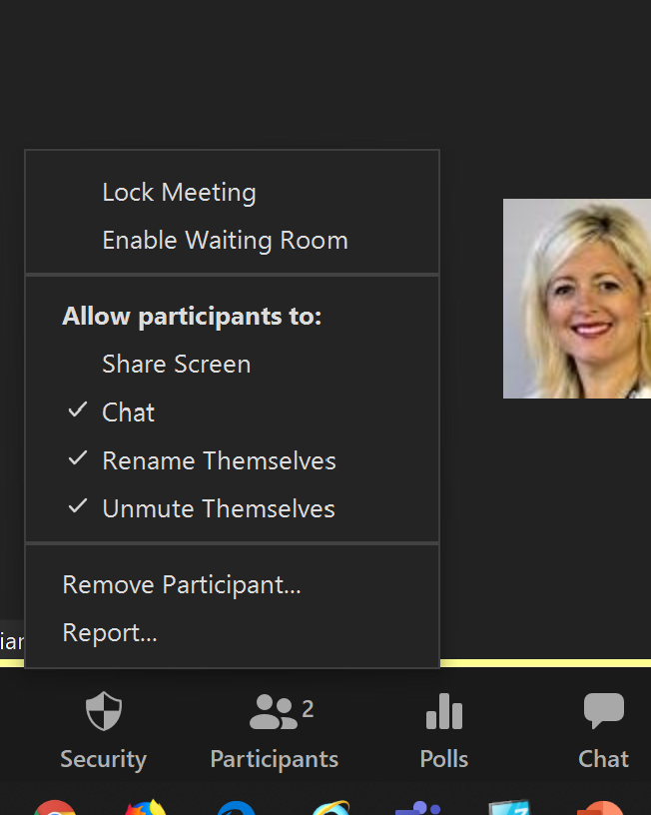
Within session settings

Slide 19
Explore this page…

Slide 20
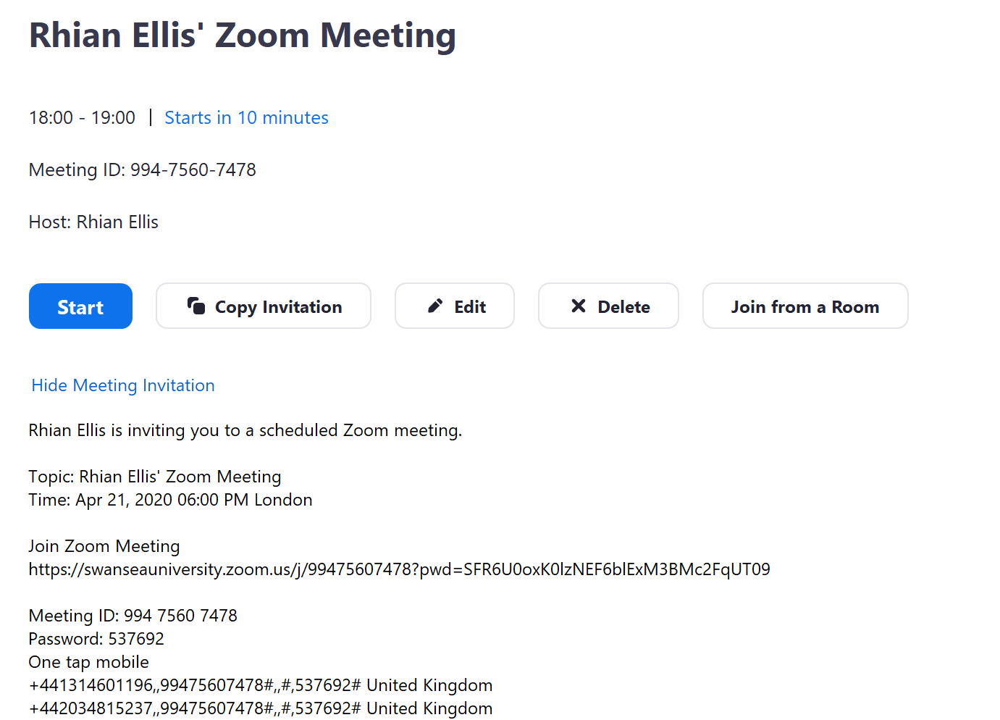
Joining Info

Slide 21
If scheduled from your account, you can use Outlook/Email/Meeting Requests:-
1. With Outlook integration, a meeting request will automatically generate allowing you to add participants individually or via a mailing list
2. Or ‘Copy the invitation’ or manually extract the invitation text & paste it into an email message
Ways to share the joining info

Slide 22
Scheduling Meetings in Canvas
If you have a Canvas course for the intended audience, this is the best way
The form looks similar (Some screenshots to follow)
The link will be embedded in the course and it’s calendar - best for large numbers of students.
All Zoom meetings booked on Canvas have the recordings automatically uploaded to Panopto (if recorded).
Ways to share the joining info

Slide 23
Zoom Registration
You can create a Zoom registration link to go with a meeting (covered in our Advanced Sessions).
The link goes out by email with the registration confirmation.
This has some benefits, but only if you don’t have a Canvas course.
Ways to share the joining info

Slide 24
Inviting from within a live session
For individuals/very small numbers, view this like a telephone call.
Ways to share the joining info

Slide 25
Ways NOT to share the joining info
AVOID SHARING LINKS (OR STREAMING SESSIONS) ON SOCIAL MEDIA

Slide 26
Zoom - Web Version
https://swanseauniversity.zoom.us/

Slide 27
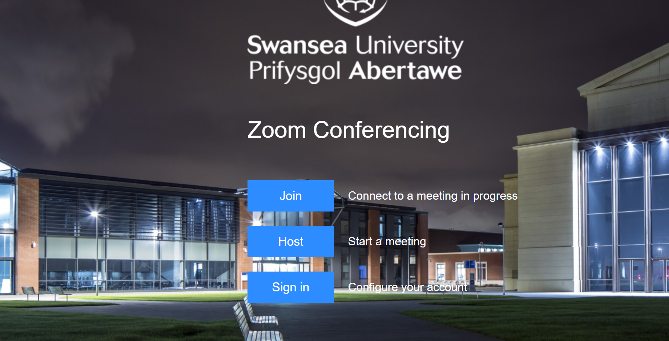

Slide 28
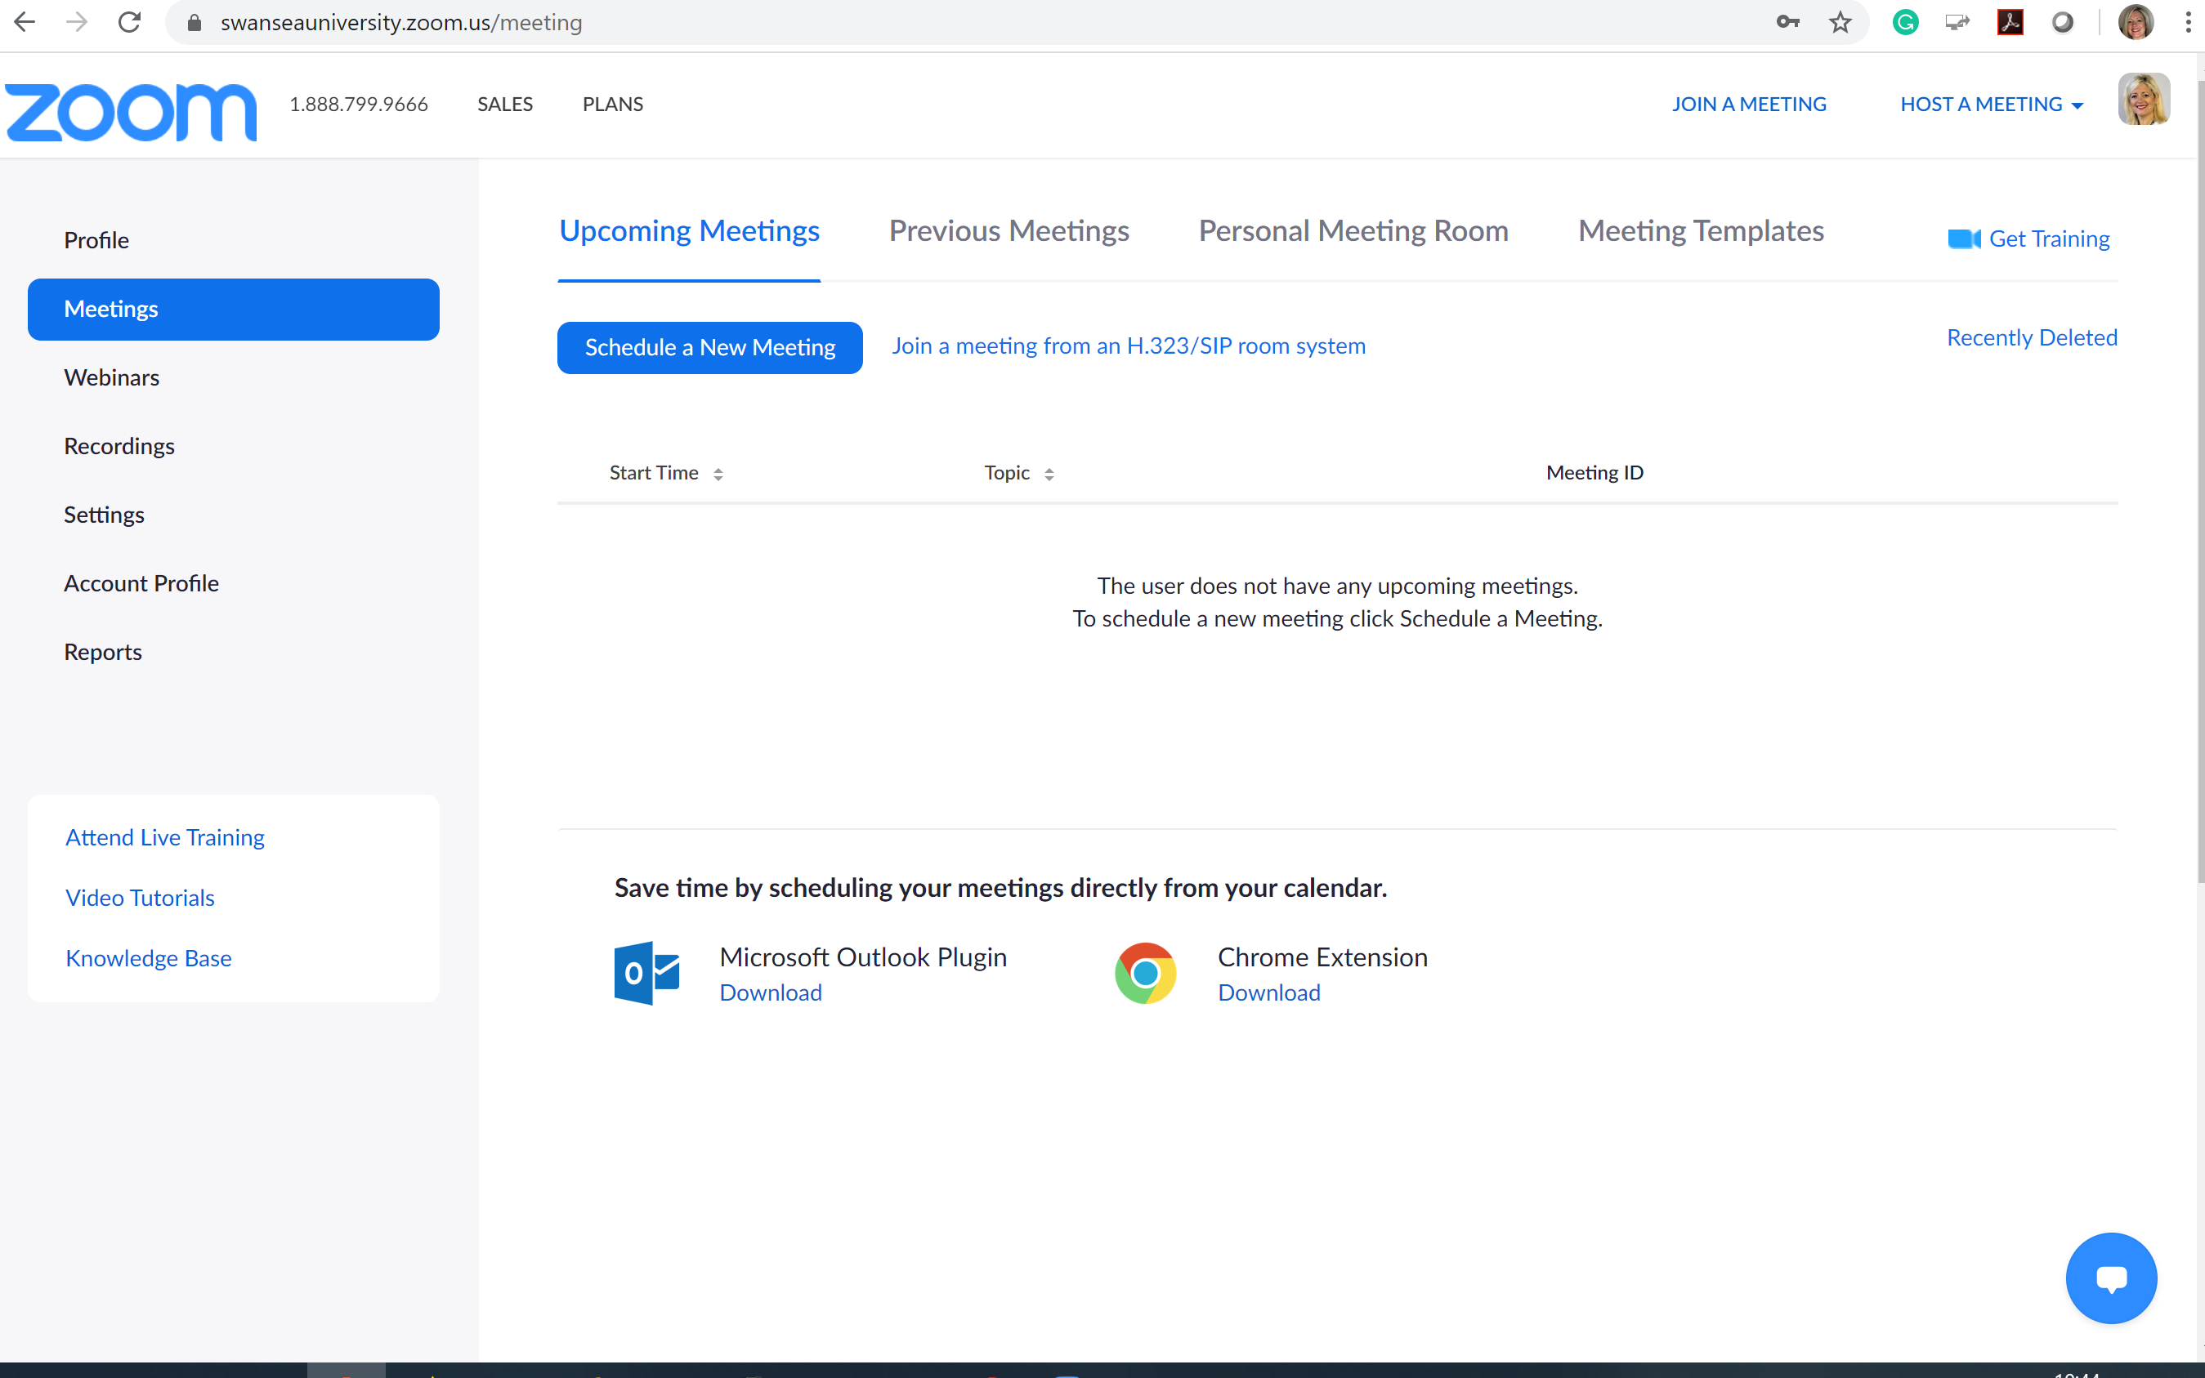

Slide 30
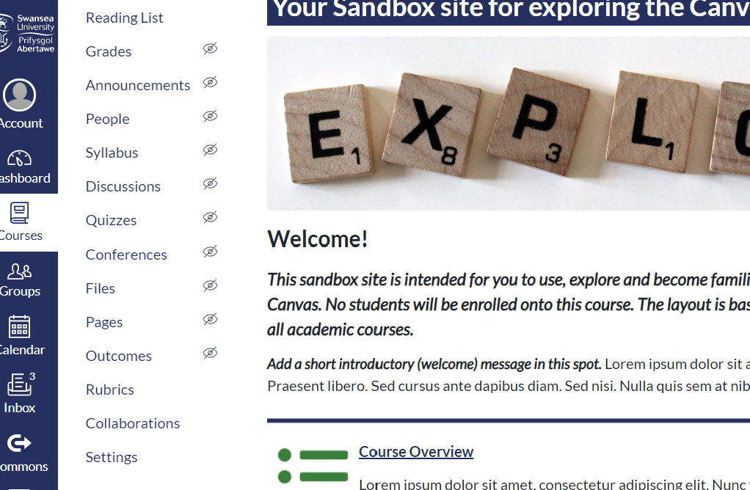
CANVAS integration
Go to settings in your course…

Slide 31
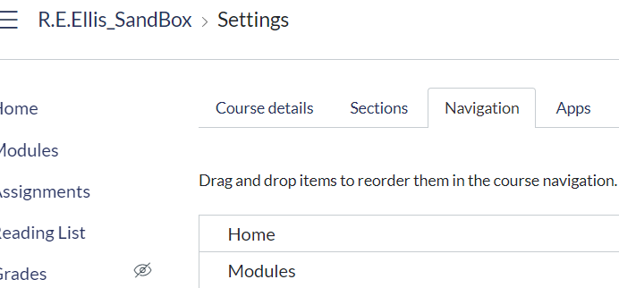
Go to
‘Navigation’

Slide 32
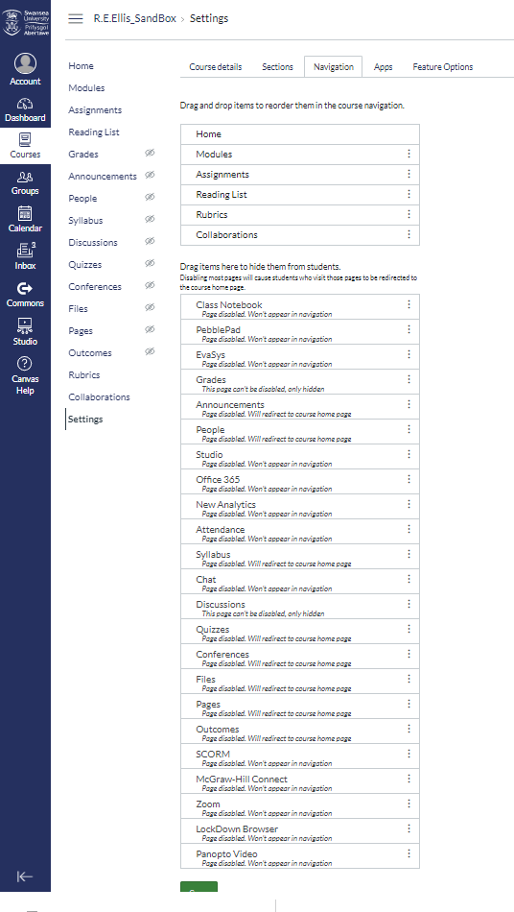
Tools - Zoom will be at the bottom …
Drag and drop it up to the top box.

Slide 33
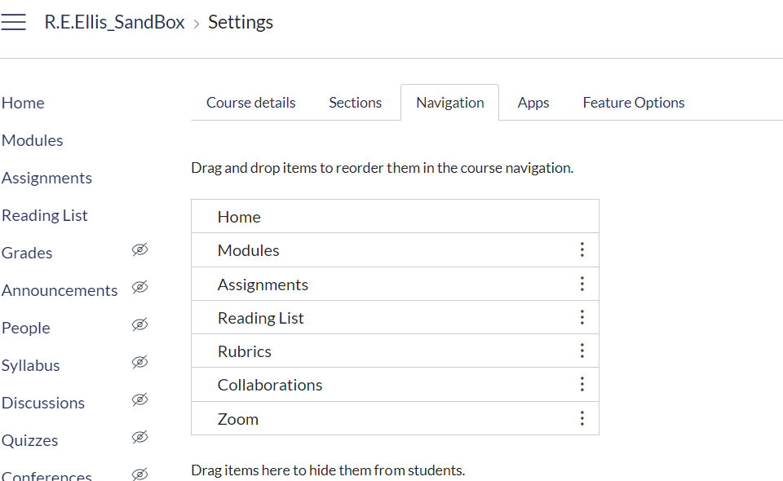
So that it sits here …

Slide 34
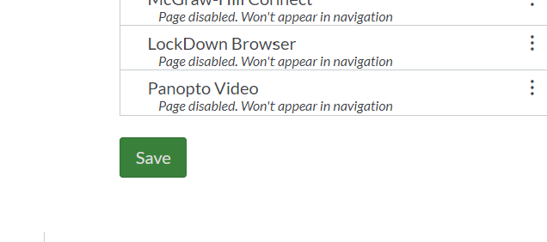
Don’t forget to SAVE…

Slide 35
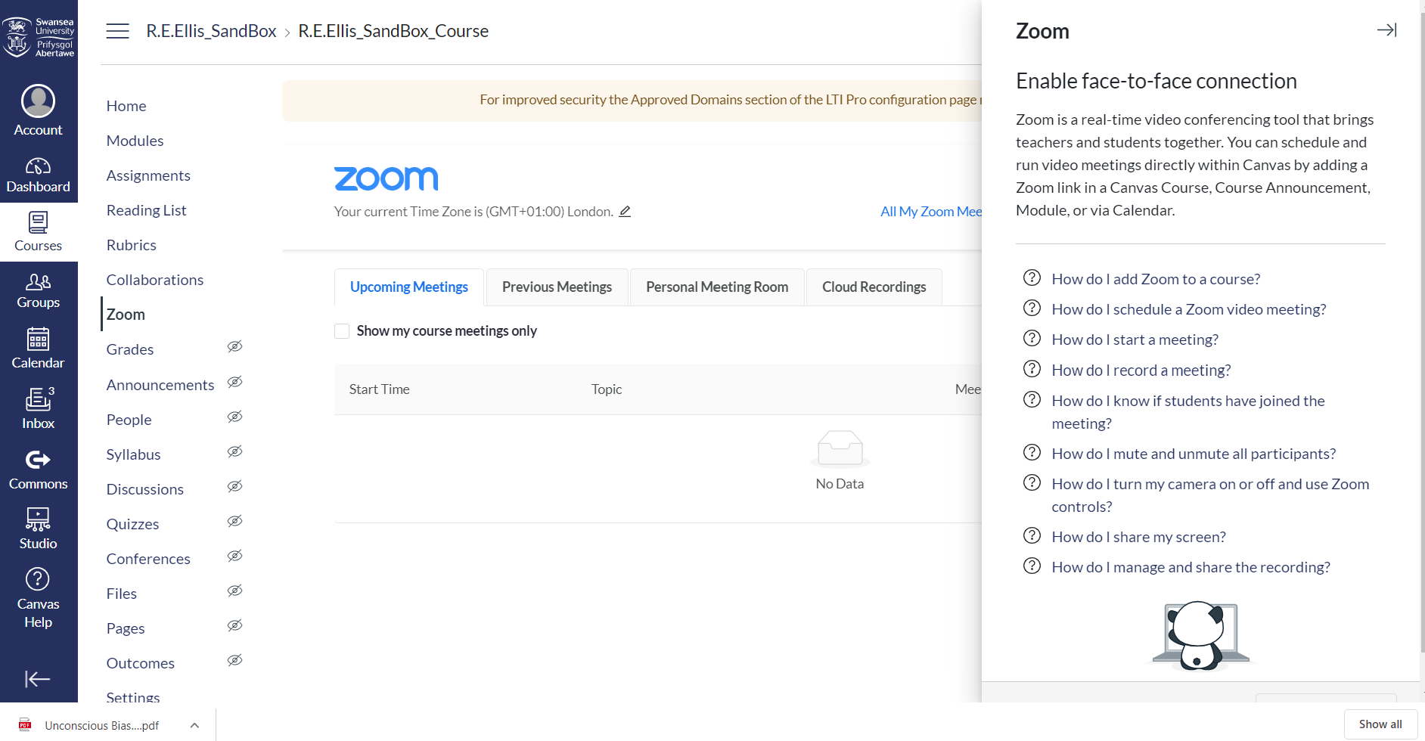

Slide 36
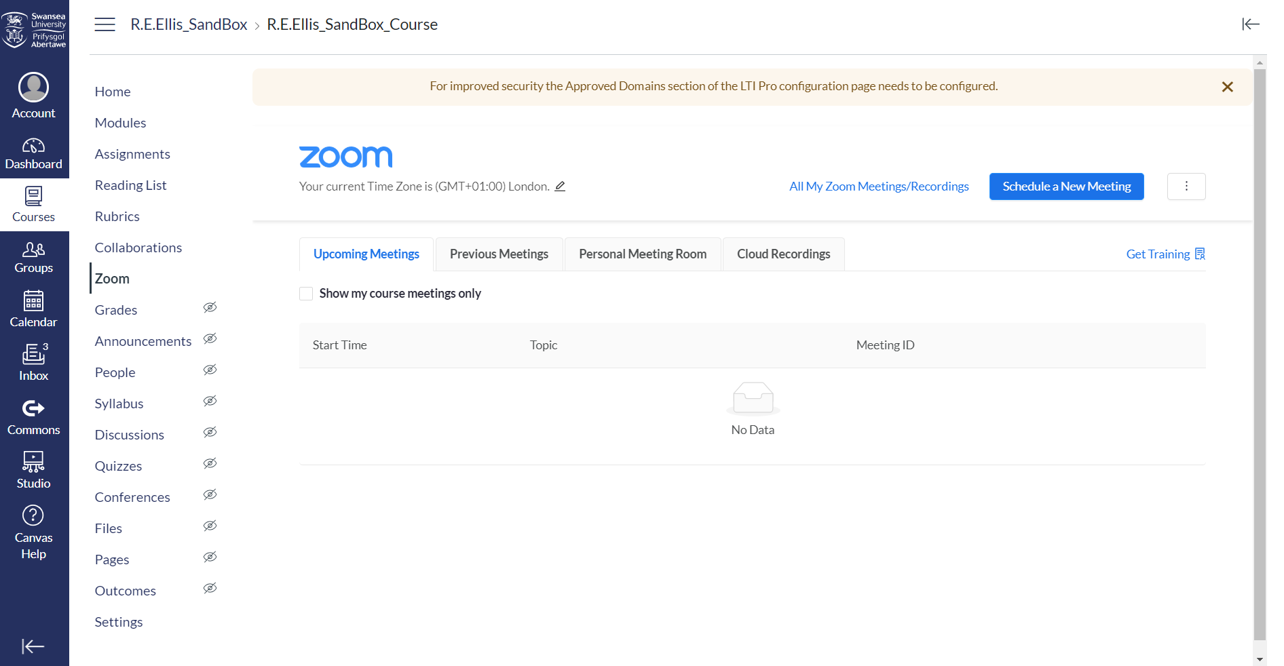

Slide 37
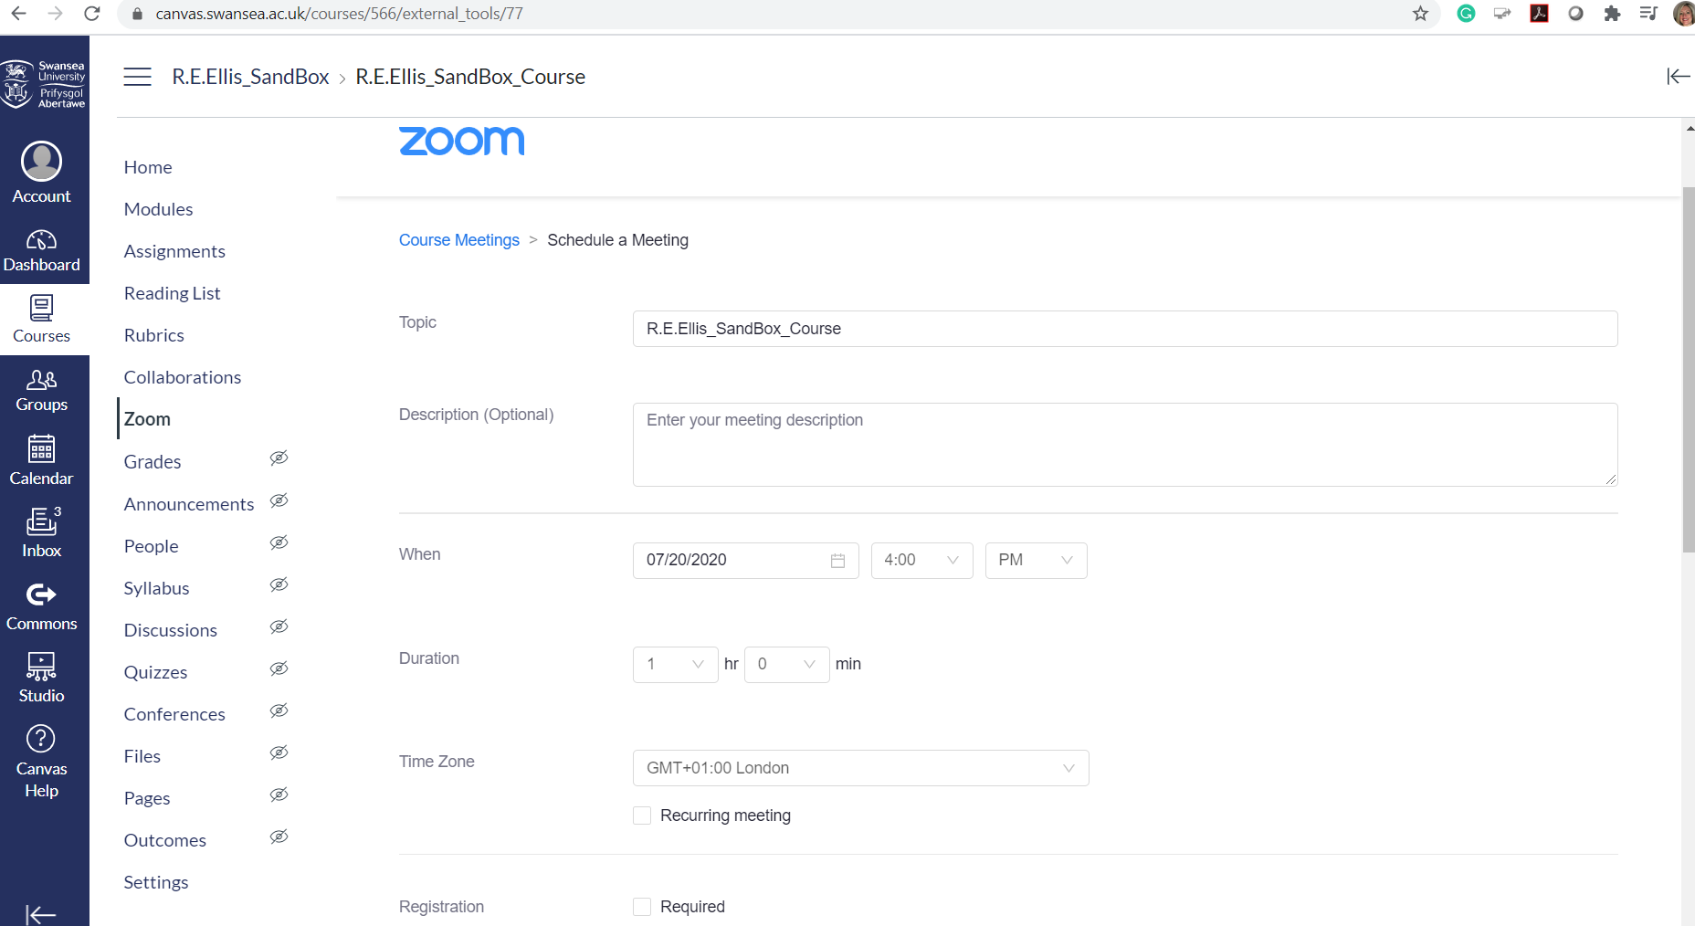

Slide 38
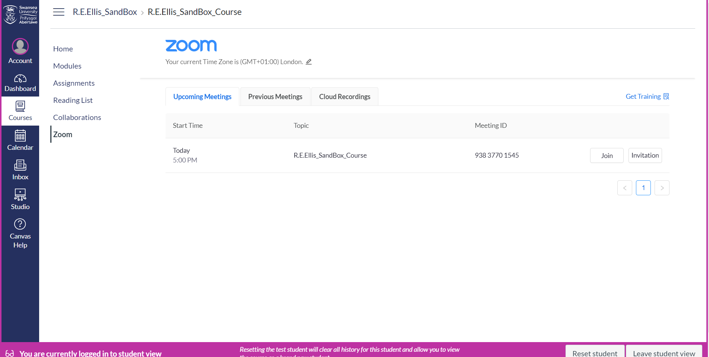

Slide 39
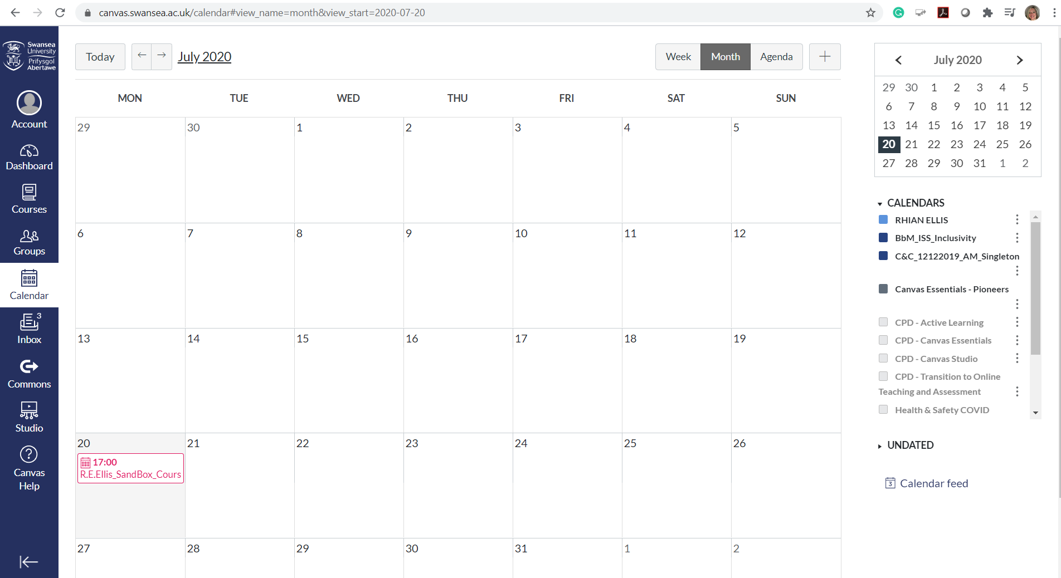

Slide 40
‘Using Zoom for Lecturing’ Staff Support Page
https://staff.swansea.ac.uk/it-services/remote-lecturing-technology/using-zoom-for-lecturing/

Slide 41
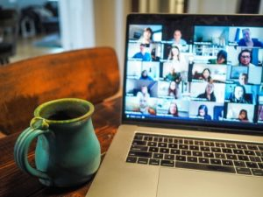
3. Engaging and interacting with students
Quick tour of key functions.

Slide 42
Key functions …
Chat
Sharing mic & video
Share screen

Slide 43
Chat
More to chat than first appears.
Think about what will suit your session and
manage it accordingly e.g. turn on and off, review at
set points.
Everyone can save their chat – to retrieve links, check Qs
etc. ‘Private’ chats can also be managed.
File sharing – be mindful.

Slide 44
Key functions …
Chat
Sharing mic & video
Share Screen

Slide 45
To mute or not to mute …?

Slide 48
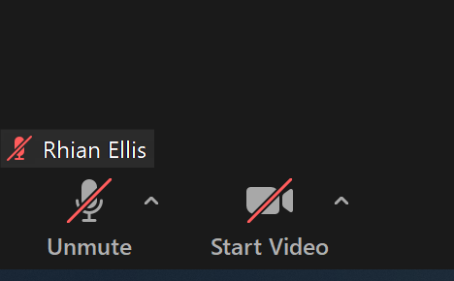
Audio/Video
BE MINDFUL OF YOUR OWN STATUS AND THAT OF OTHERS!
At the start of your meeting…
If MUTE is preferred, check the correct boxes at SET UP stage.
Audio & Video may then be switched back on by participants
Within-meeting settings can disallow audio self-unmute
Manage this with clear communication

Slide 49
Audio/Video
During your meeting …
H/CH can mute AUDIO - ALL or individually (various ways)
H/CH can mute individual VIDEOS, and Zoom has recently introduced participants not being able to switch them back on
If participants have muted own audio or video, C/CH can ask them to switch them back on (discreet Zoom alert)
n.b. NO ‘MUTE ALL’ FOR VIDEO In MEETINGS

Slide 50
Audio/Video
So, some tips …
Start as you mean to go on
Invite audio and video sharing at regular points
Remember, no-one can be pressured
Try to create an atmosphere where people feel comfortable to share

Slide 51
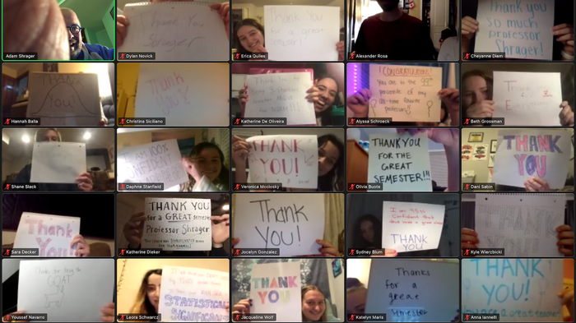
Notes:
Picture courtesy of https://www.insider.com/tiktok-college-students-surprise-professor-with-thank-you-message-2020-12

Slide 52
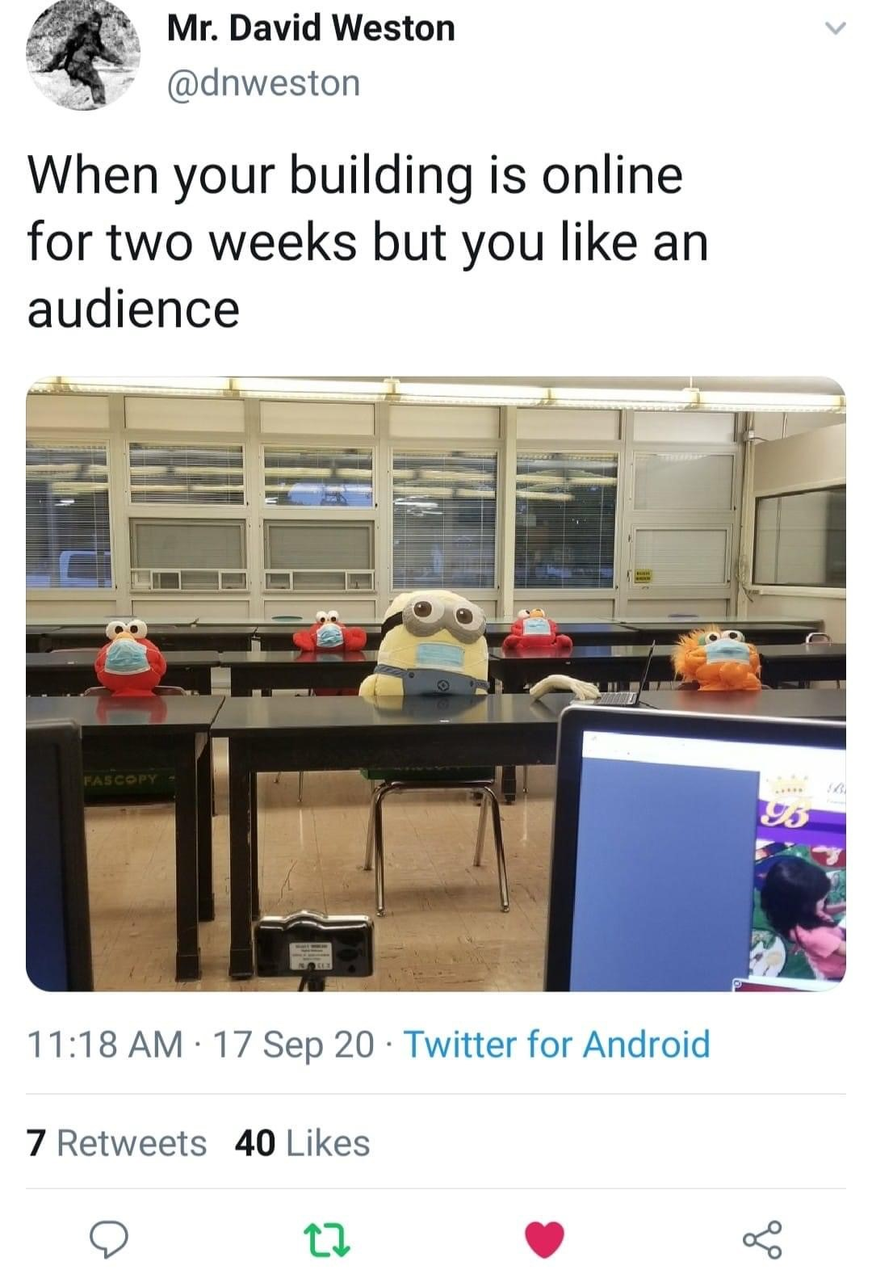

Slide 53
Key functions…
Chat
Sharing Mic and Video
Share Screen

Slide 54
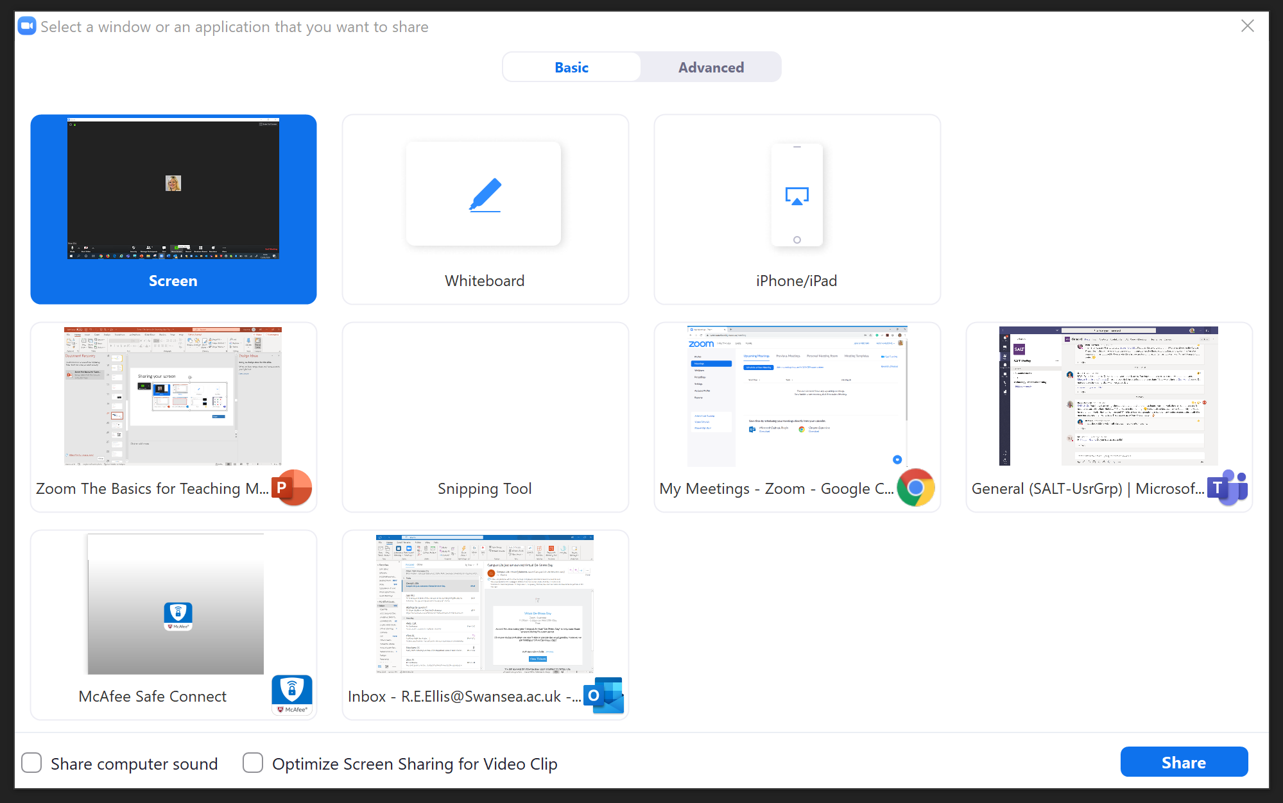
Sharing your screen
n.b. Participants are now defaulted to NOT being allowed to screen share., which can be re-enabled in a few different ways

Slide 55
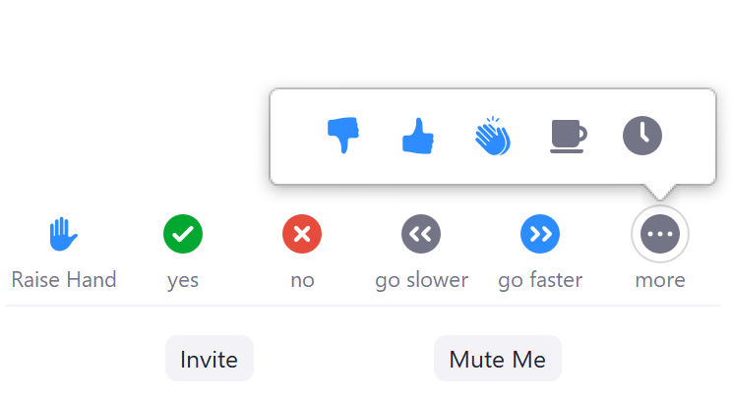
4. Some other ways of interacting
From the ‘Participants’ button…
n.b. hosts don’t have the ‘Raise Hand’ icon. Not to be confused with the Wave!

Slide 56
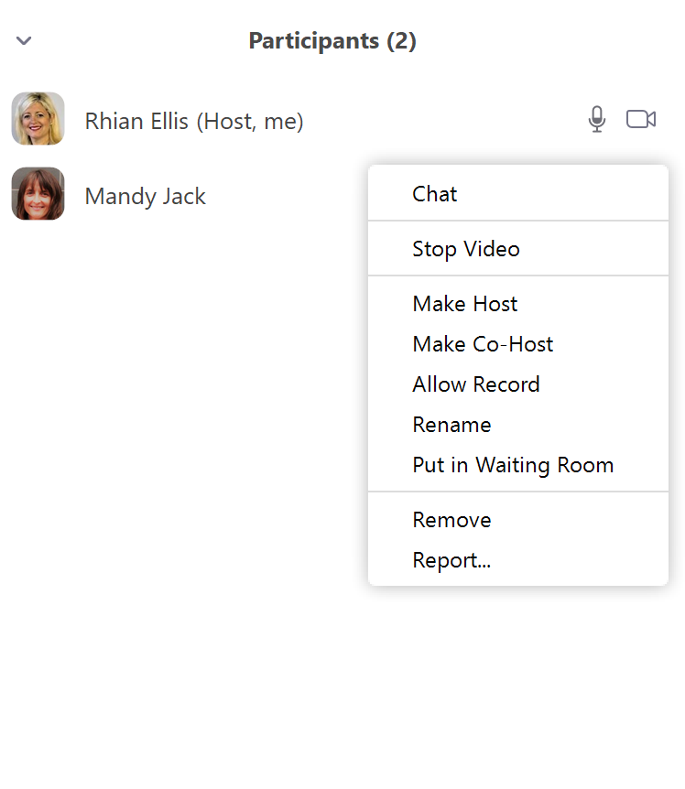
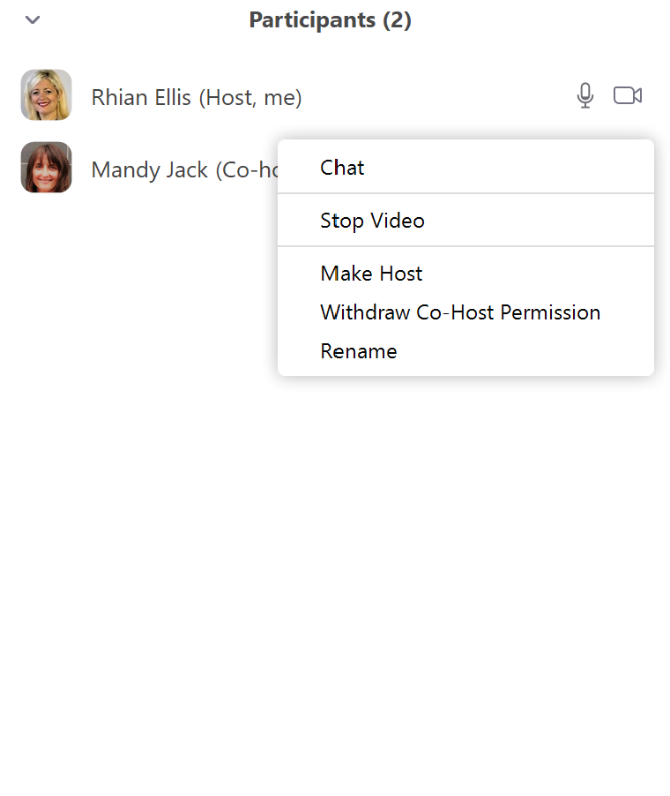
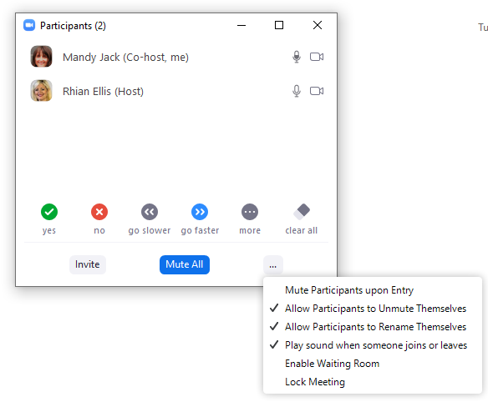

Slide 57
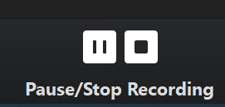
5. Recording your session (the basics)

Slide 59
We set out to learn about… Green ticks or Red Crosses?
1. Some introductory things…
2. Setting up, managing and sharing ‘Meeting’
links, with a view to ‘Hosting’ (teaching) with
Zoom
3. Engaging and Interacting with students:-
Chat
Sharing mic & video (webcams)
Screensharing
4. Signpost to other ways of interacting
5. Briefly touch upon recording
Along the way ….some GDPR / security reminders

Slide 61
Next Steps…
Get to know your settings and your account
Set-up a session & get some hands-on experience
Come to a SALT Advanced session when you feel ready, and join our workshops

Slide 62
Let’s give students positive experience of…
‘Waiting Rooms’
‘Breakout Rooms’
Whiteboards and annotation
Polling
Sharing audio and video clips with optimal quality
Taking part in presenting

Slide 63
It will take time to learn how to…
Use your Zoom Reports to reflect on and build upon learning
Use Canvas integration to save you time
Maximise security in your sessions
Design your slides well, pace sessions well,
Build rapport and ‘humanise’ the online classroom
Locate, edit, share and managing your recordings
Give participant’s recording permissions

Slide 64
SALT Support https://salt.swan.ac.uk/
Pedagogic Zoom support
Email: salt@Swansea.ac.uk or the team
Updates from SALT via all academic staff emails
SALT ‘Upcoming Events’
https://www.eventbrite.co.uk/o/swansea-academy-of-learning-and-teaching-salt-2039312959

Slide 65
Self Directed Resources
Guides, FAQs, Asynchronous Video Recordings
https://salt.swan.ac.uk/maintaining-lt-continuity/
Resources for Teaching
https://elink.io/p/resources-for-teaching-9225da0
More CPD to come soon…

Slide 66
Technical Support
ISS Service Desk
Via staff.swan.ac.uk
Select MyApps
WVN-Support@swansea.ac.uk
Zoom info on staff Intranet:
https://staff.swansea.ac.uk/it-services/zoom/
https://staff.swansea.ac.uk/it-services/remote-lecturing-technology/using-zoom-for-lecturing/

Slide 67
If you wish to stay…
Quick Recap & Open Mic

Slide 68
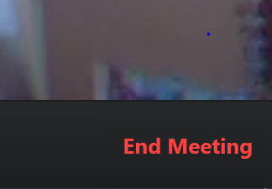
Thank you! Keep safe & well
To leave the meeting…
n.b. Hosts are asked whether they wish to end the meeting for all, or leave & make someone else the Host.

