Slide 1
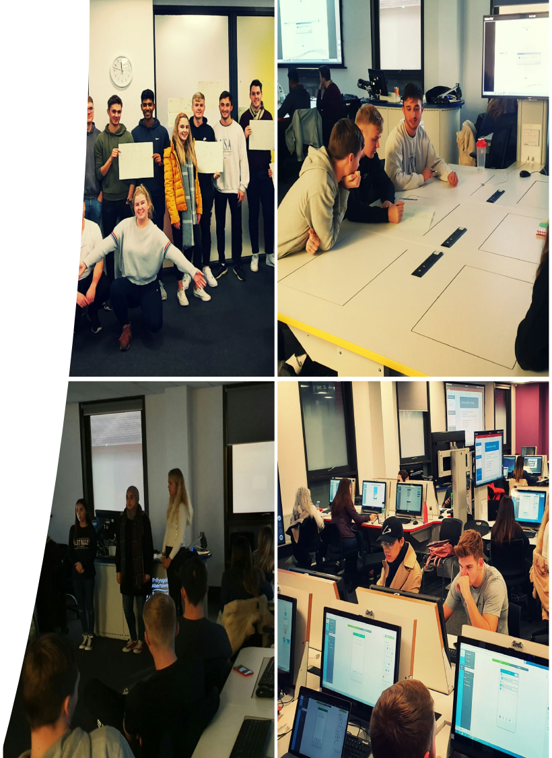
Practical Tips
To improve feedback
Paul Davies
Senior Lecturer & Prog Dir
School of Management

Slide 2
> FRAMING <
My practical tips on making students feel like winners whatever the grade they get. How to gain buy in; buy in and actions from your students that can supercharge your KPI’s, boosting response rates & qual feedback & generally make life better – for everyone.

Slide 3
> FRAMING <
Is what I say credible?
I don’t have all the answers, nobody does, but here are the figs
Last 4 years KPI data - 4 modules (L5,6,7)
Feedback = 4.5
Average module response = 40%
Average module size = 95.2 students
Average module mean = 57-61%
(Summary: hundreds of student comments, so that’s a lot of feedback and not because I’m just dishing out marks or teaching tiny modules)

Slide 4
TIP 1: Frame it
Reposition Feedback
… not just a grade they get
… as something that happens EVERY session, every single interaction with me & with each other
Establish Community
… immersive learning community (social, peer, canvas, zoom)
Set Goals
… ‘our’ goals – we are partners
… Fail fast, Fall Forward
… join the dots (Steve Jobs)

Slide 5
TIP 2: Rubricerize!
Benefits
… saves you time and headspace
… EE’s love it
… students ‘get it’ i.e. what they need to do *
… adds transparency & consistency *
*Combine with quick marks – add in qual comments, don’t just use in isolation. Students see that as lazy, you would too
*Ask students to visualize where they want to be on the charts

Slide 6
TIP 2 (and a half)
Say as you go – Two way communication – check steps

Slide 7
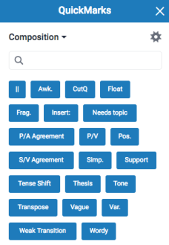
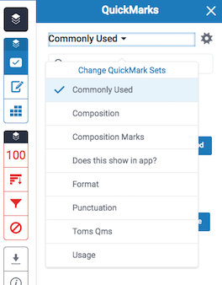
TIP 3: Quick marks
Benefits
… REALLY saves you time and headspace
… easy to set up
… BUT make specific to topic / subject
… students ‘know’ you’ve really digested their hard work

Slide 8
TIP 4: Structured help
The Good, the bad and the … what you can do next!
… Give an overview, summary
+ REWARD Students
… 3 plus points / things you did well
… 3 areas where you can improve
Provides a pathway / roadmap for improving
Maybe add relevant references or notes
… links to CAS (esp L4,5)

Slide 9
TIP 5: Humanize
Critical thinking doesn’t equal ‘critical’ language
Encouraging tone
Try being softer more emotive
We’re all human beings – they have all done their best basically
Pose questions … why didn’t you give thought to ? (open questions)
I really enjoyed …
I didn’t quite understand …
This was great, but it didn’t really answer the question …
Specific and positive, helpful

Slide 10
Other things …
Peer feedback (formative) enabling social learning
Zoom, Canvas groups – whiteboard together on generic assignment feedback
Fee fwd >
VOICE FEEDBACK – WINNER!
3 mins limit on Ti, Video available on Speedgrader
Time consuming … so
Summary voice, invite one on one for more

Slide 11
A big thank you to Paul for going the extra mile and making my feedback so much more personal.
The practical element of the presentation and the immediate feedback really pointed out my weaknesses and gave me a lot to think upon and how i present myself in the future across other modules, I used these techniques with immediate effect and already got more marks.
Paul used speech marking in turnitin for this module and it has made my feedback so much more personal and it has really allowed me to understand the module further.
The feedback from the lecturer was also incredibly useful and gave us constructive points to work towards in order to push our grade boundaries; more lecturers should do this.
Paul used voice notes for feedback, I believe it took him a long time to do, but it was very worth it. I found the voice note incredibly helpful and informative. Feedback I normally find is rather lacking, but Paul made the extra effort and I believe it really helped me improve!

Slide 12
Summary
Develop your learning community by setting shared goals, re-position & humanise your feedback and help students see that feedback is constant (& from every angle). Help them develop a mental model that allows them to embrace falling fwd, help them fail faster because for them (well for all of us actually)
Feedback is the most important for learning
(anon)

